Slide 1
Brain Clearance in Mice
Initial Quality Assurance Report
February 25, 2026
Dr. B.J. Anderson, Ph.D., QIAL, Duke University Medical Center

Slide 2
QA Summary
Possibly Usable Data
APOE
CVN
Usable Data
IV
0 (0 m, 0 f)
0 (0 m, 0 f)
APOE
CVN
CM
3 (0 m, 3 f)
2 (1 m, 1 f)
IV
6 (4 m, 2 f)
6 (4 m, 2 f)
CM
4 (4 m, 0 f)
5 (2 m, 3 f)
Unusable Data
APOE
CVN
IV
1 (0 m, 1 f)
1 (0 m, 1 f)
CM
1 (0 m, 1 f)
2 (1 m, 1 f)
*Data may be improved/made usable after motion corrections (coregistration and volume pruning).

Slide 3
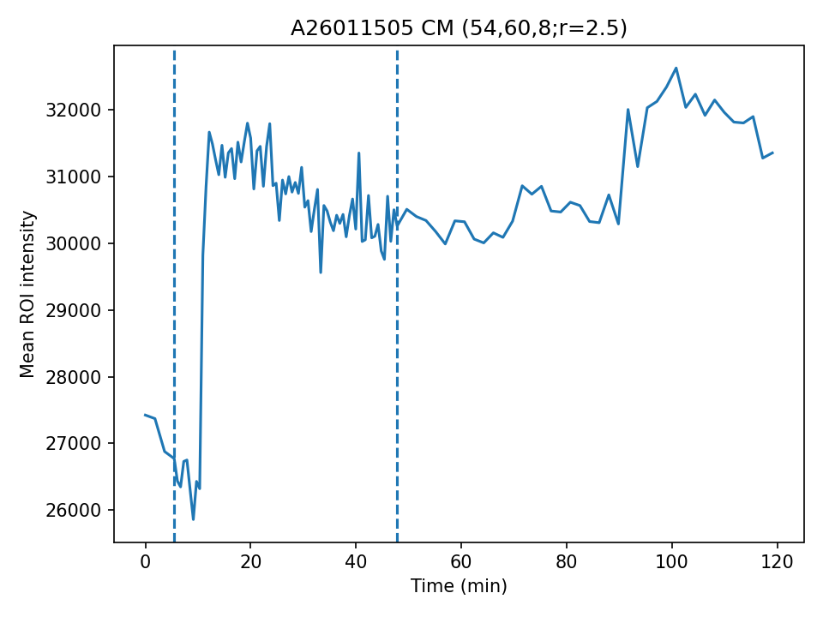
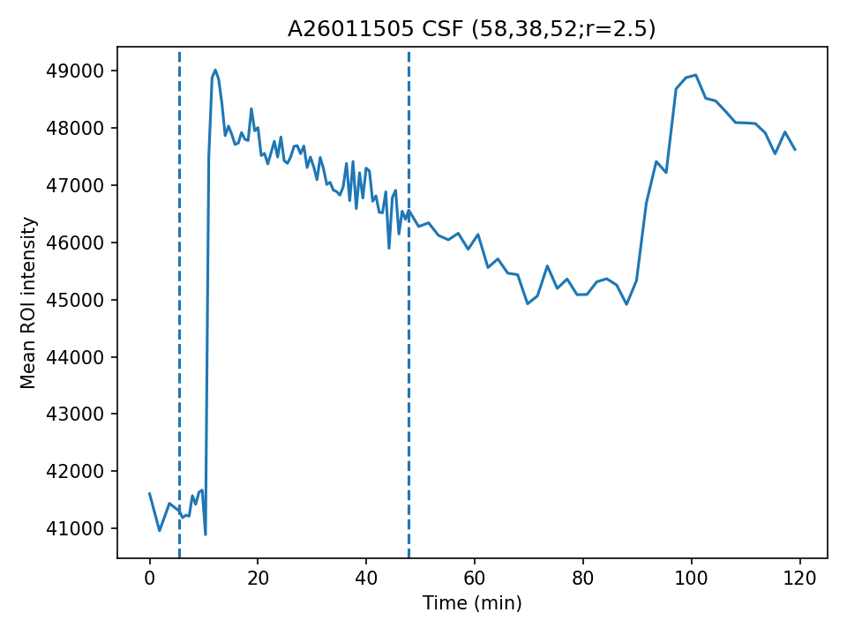
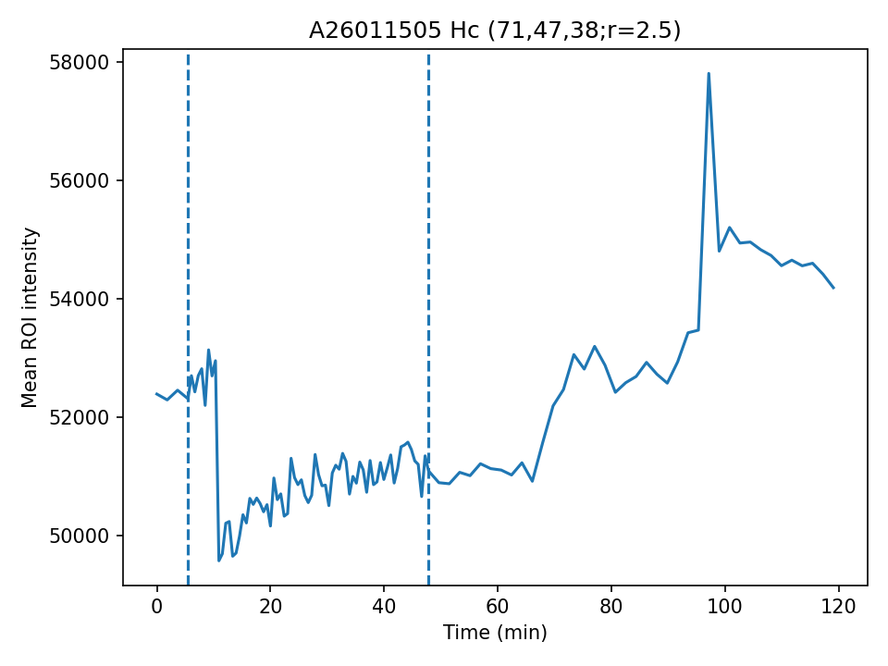
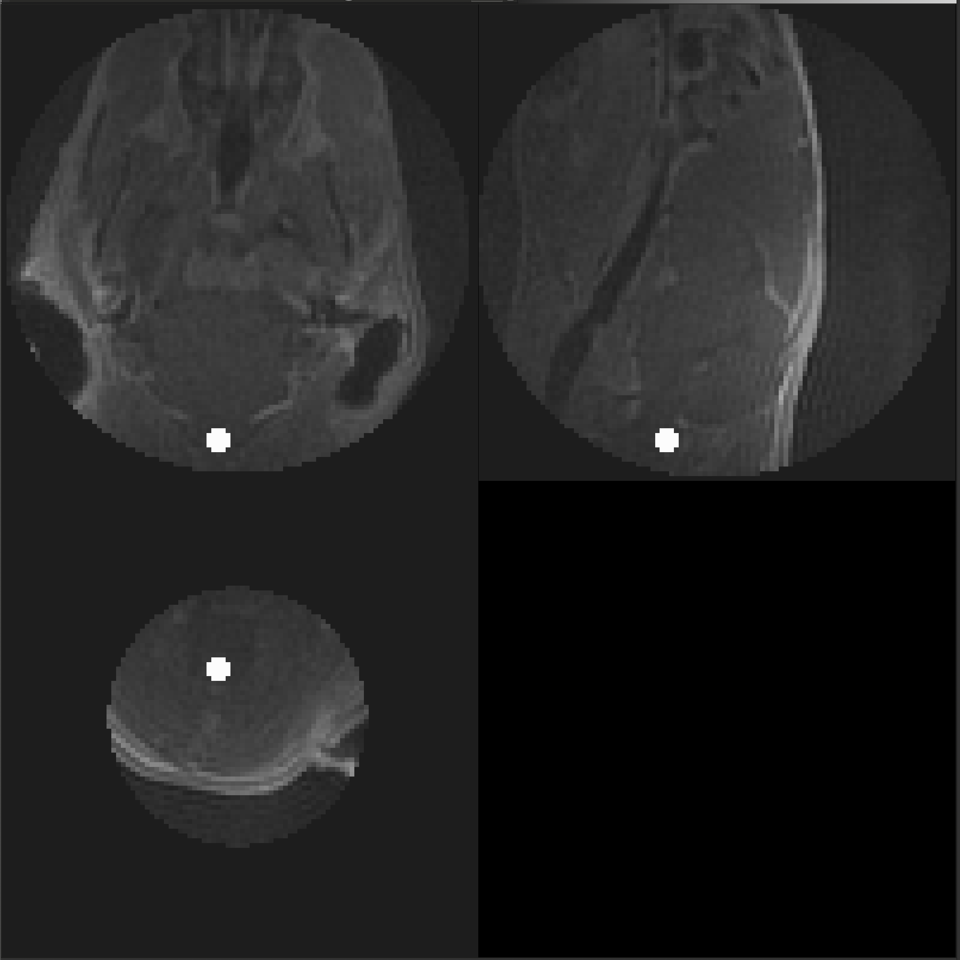
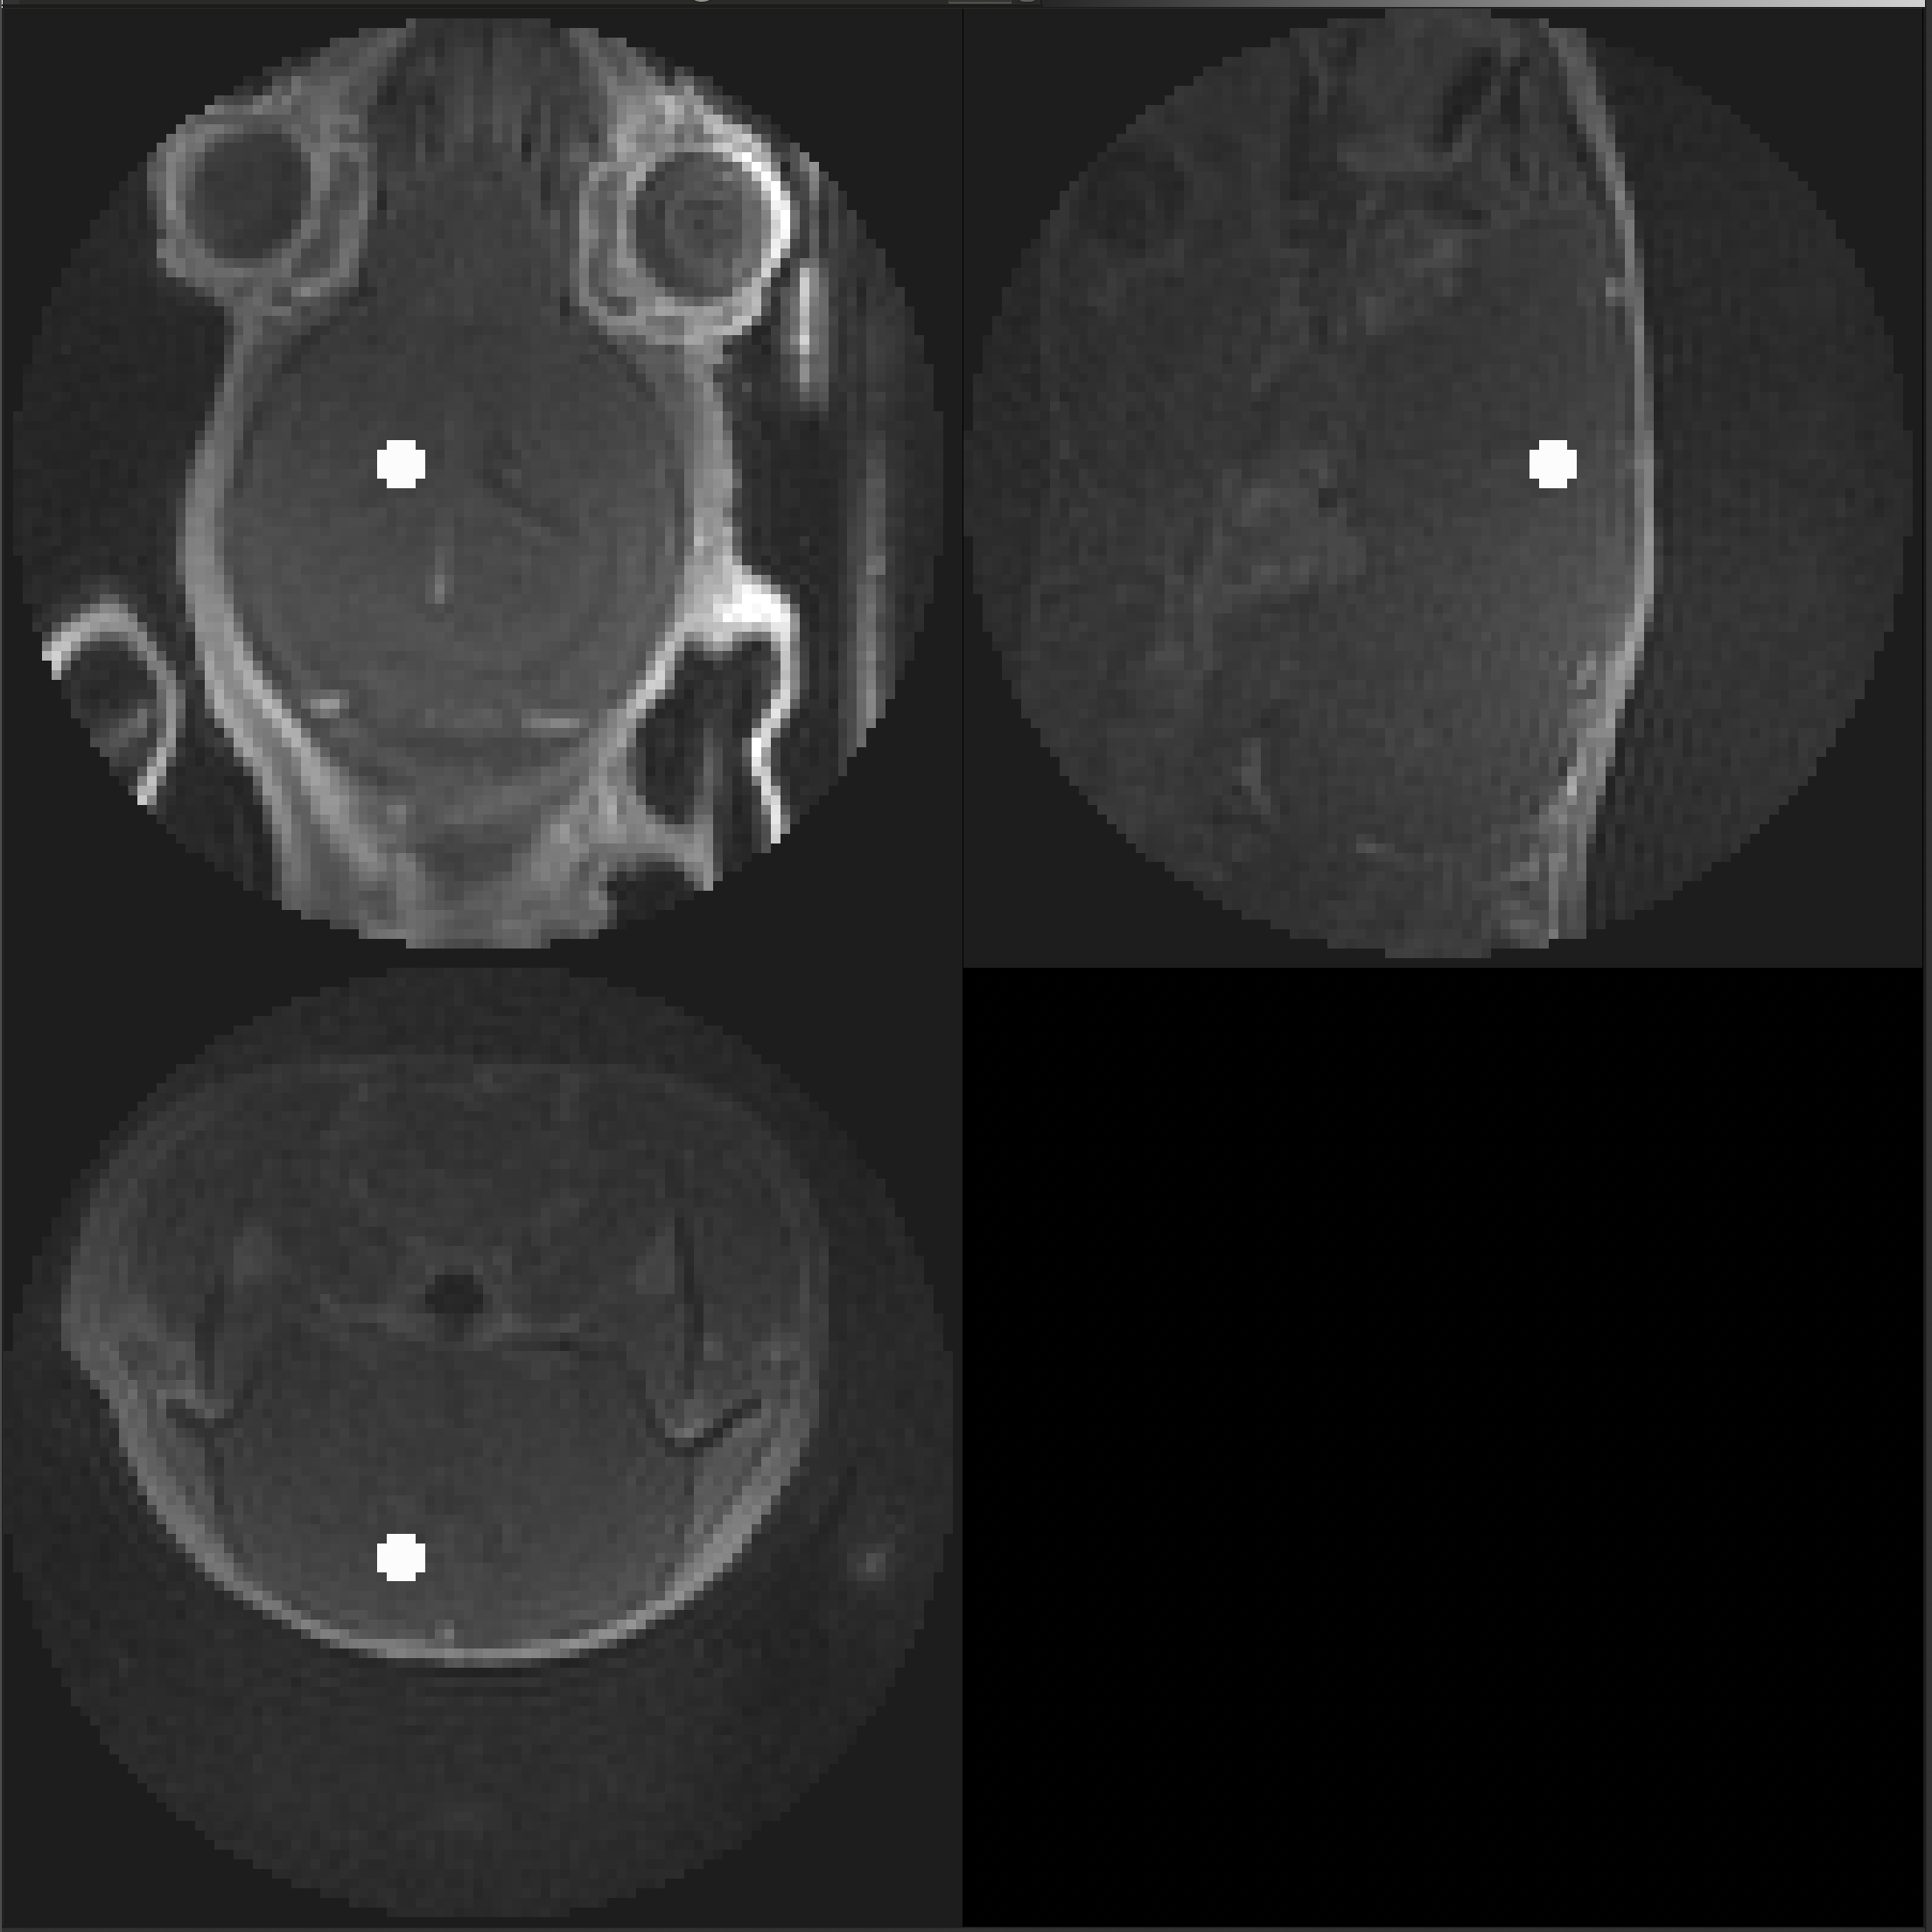
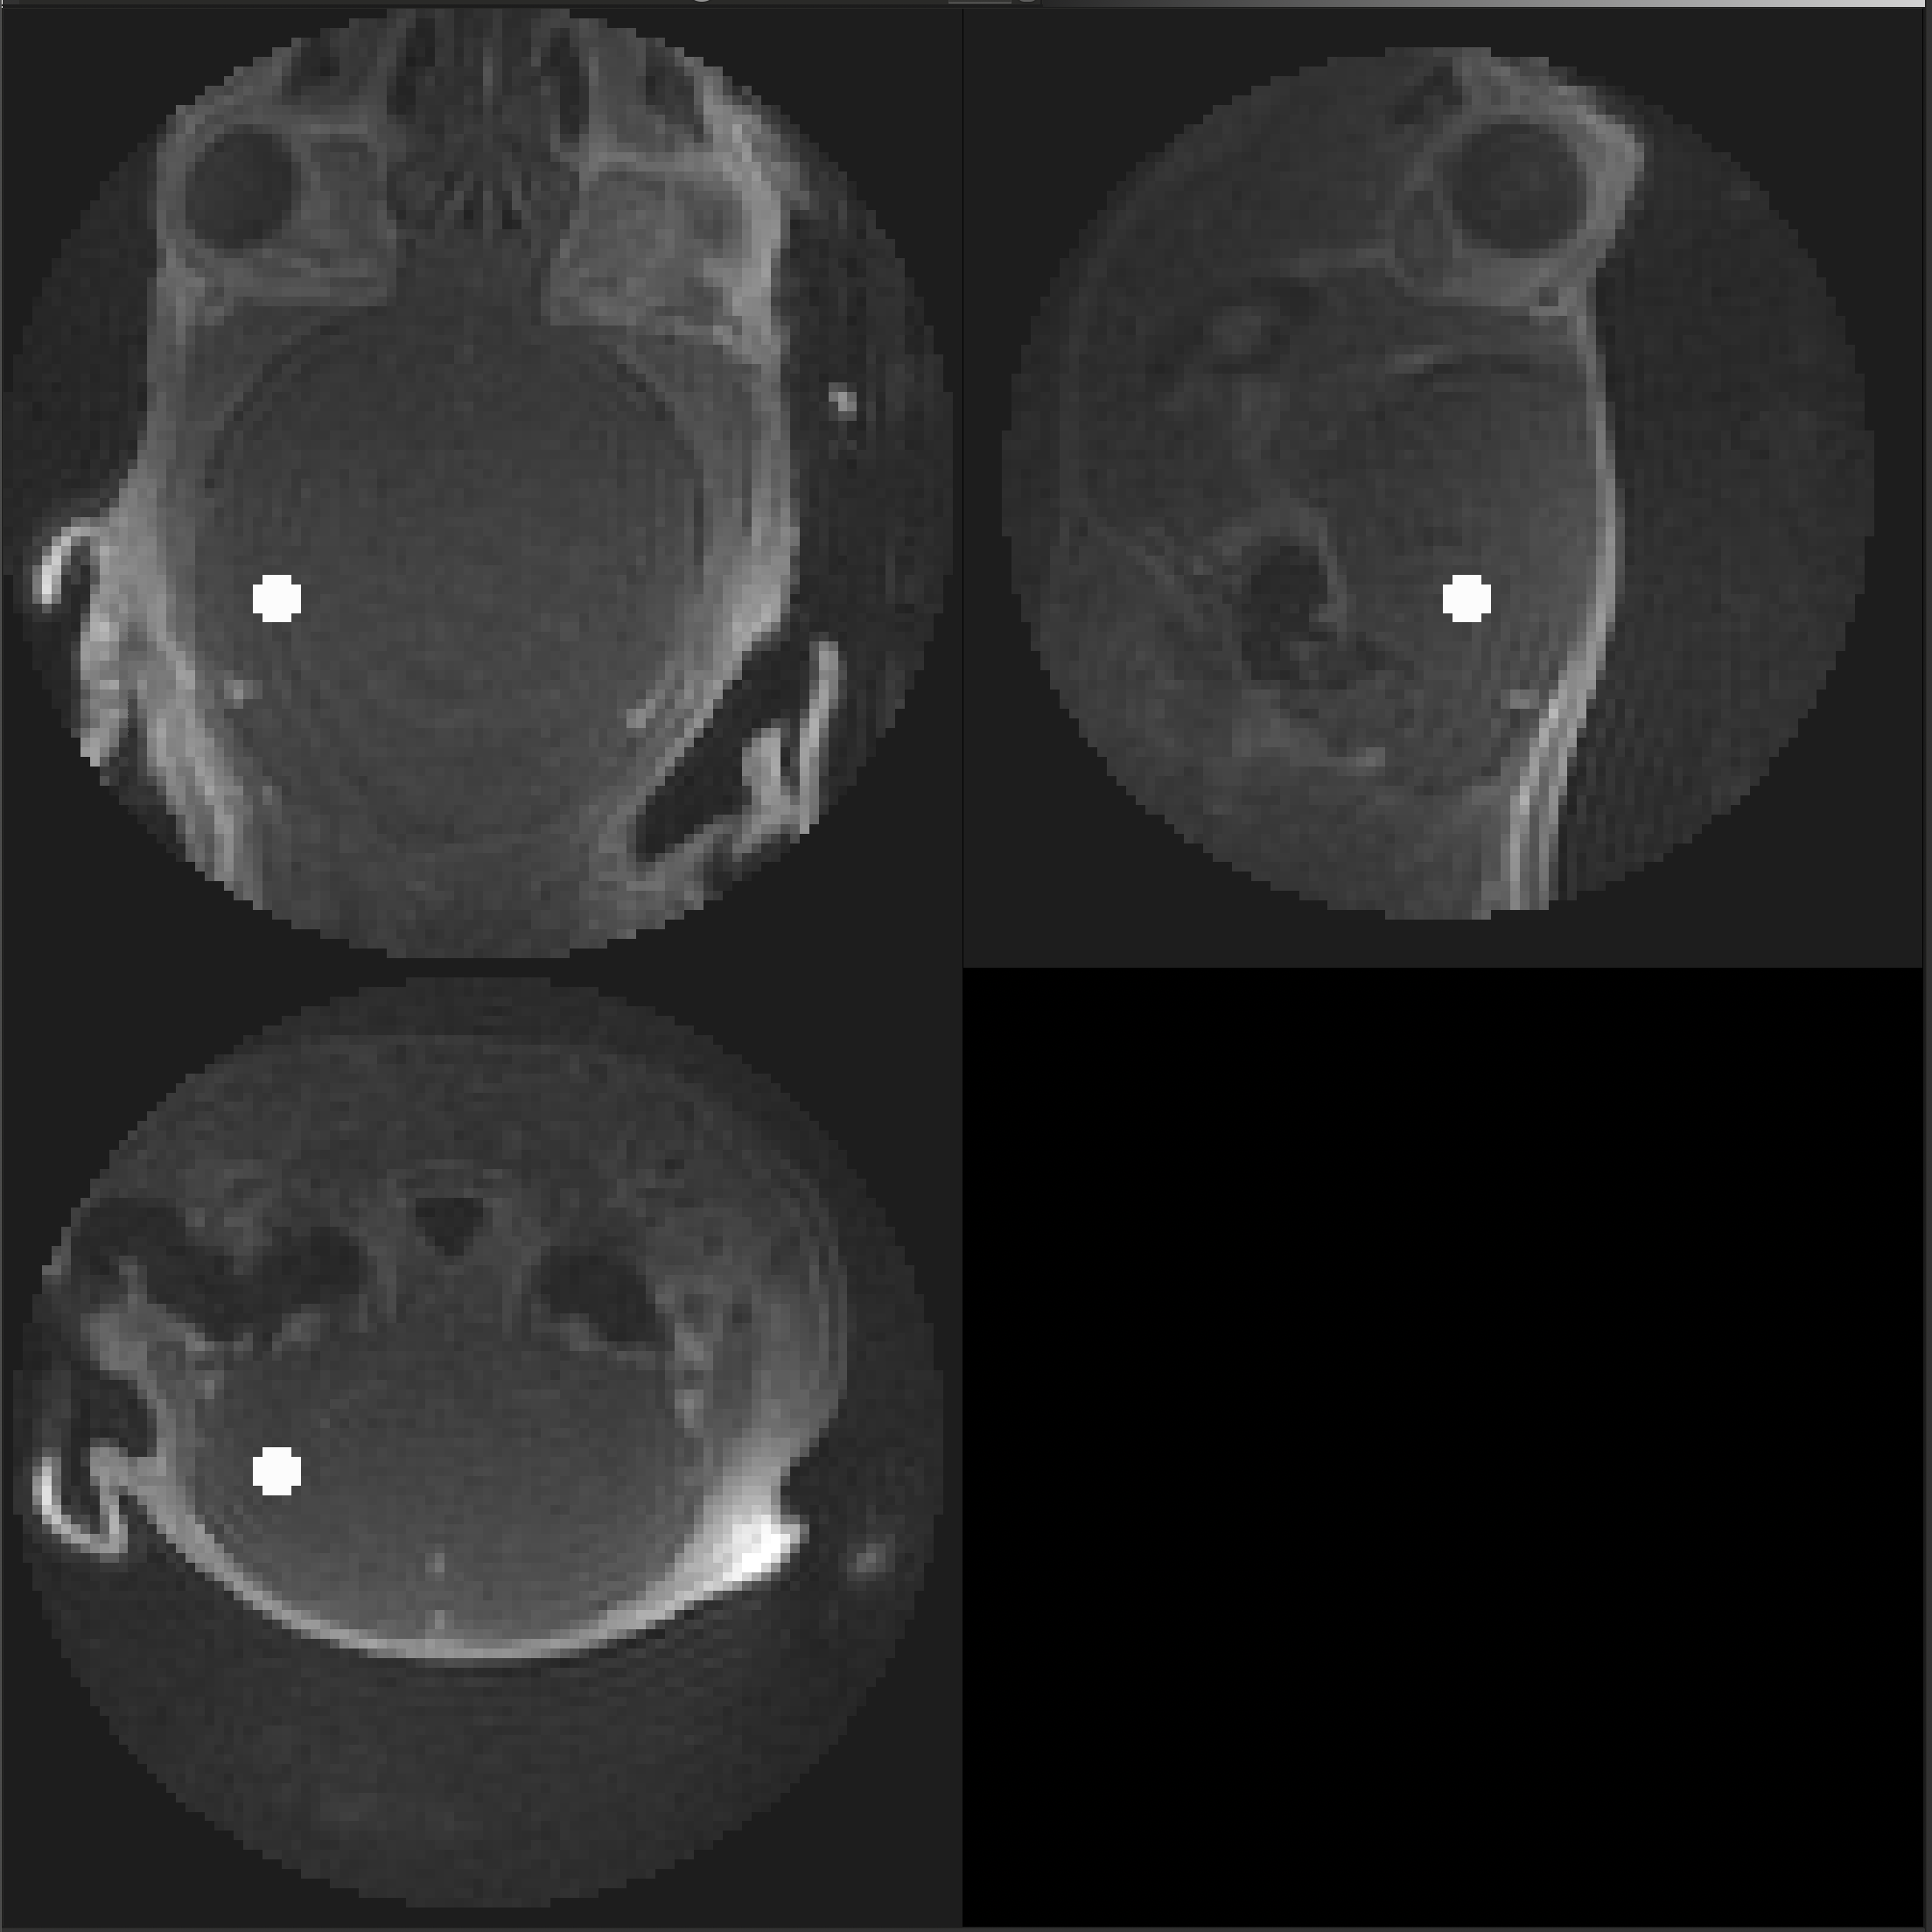
A26011505
Genotype: APOE
Method: IV
Usable: Yes
Cisterna Magna
Cerebral Spinal Fluid
Hippocampus

Slide 4
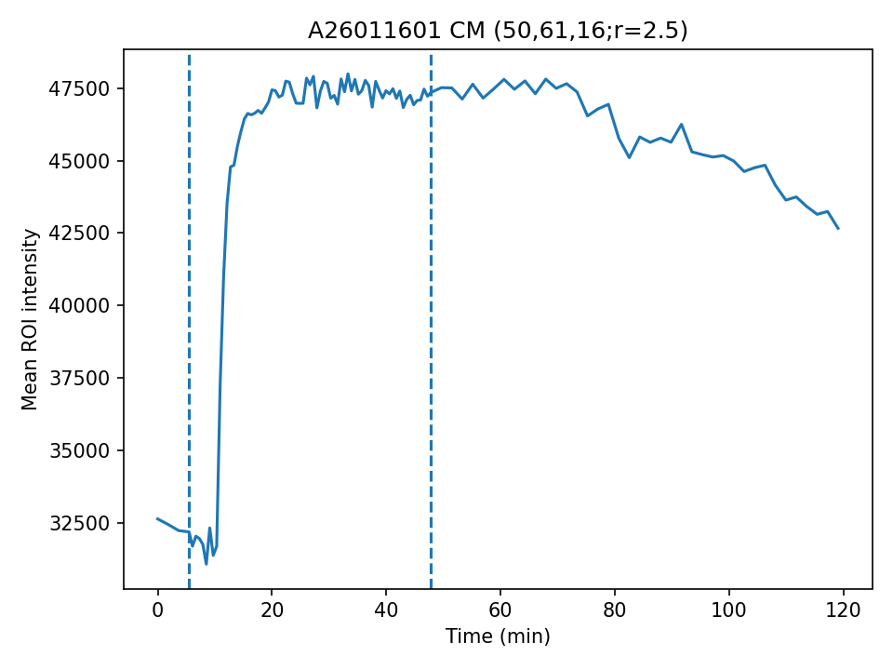
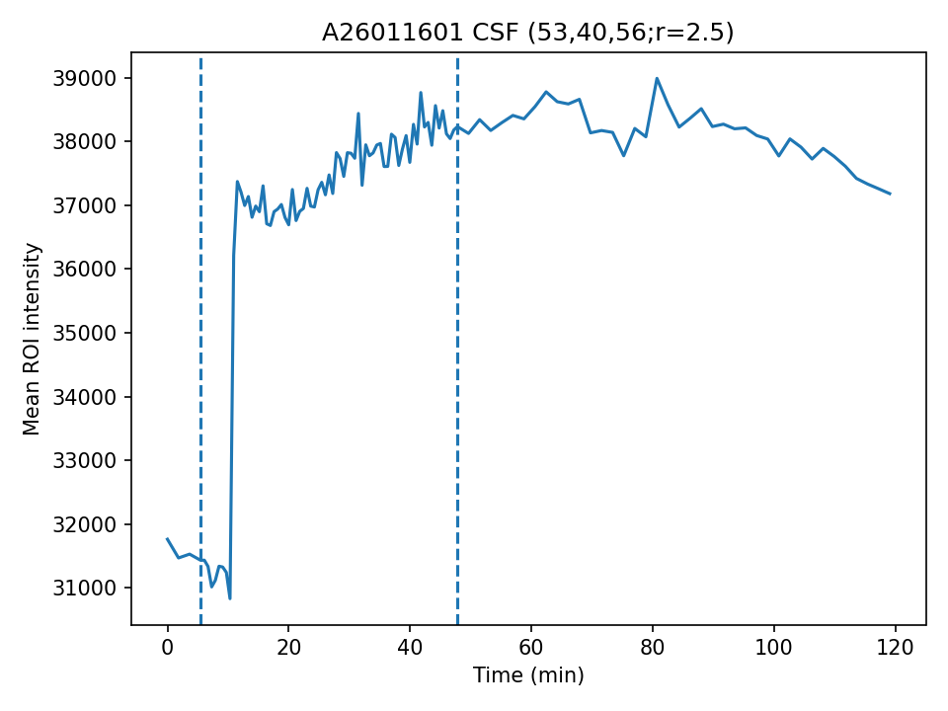
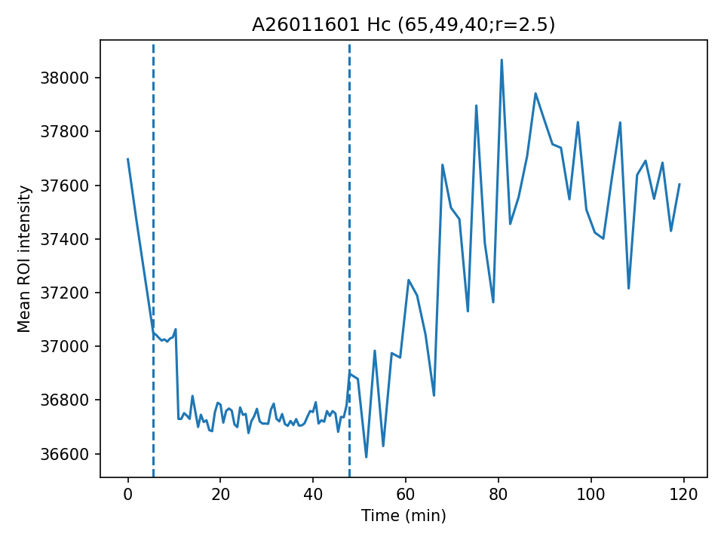
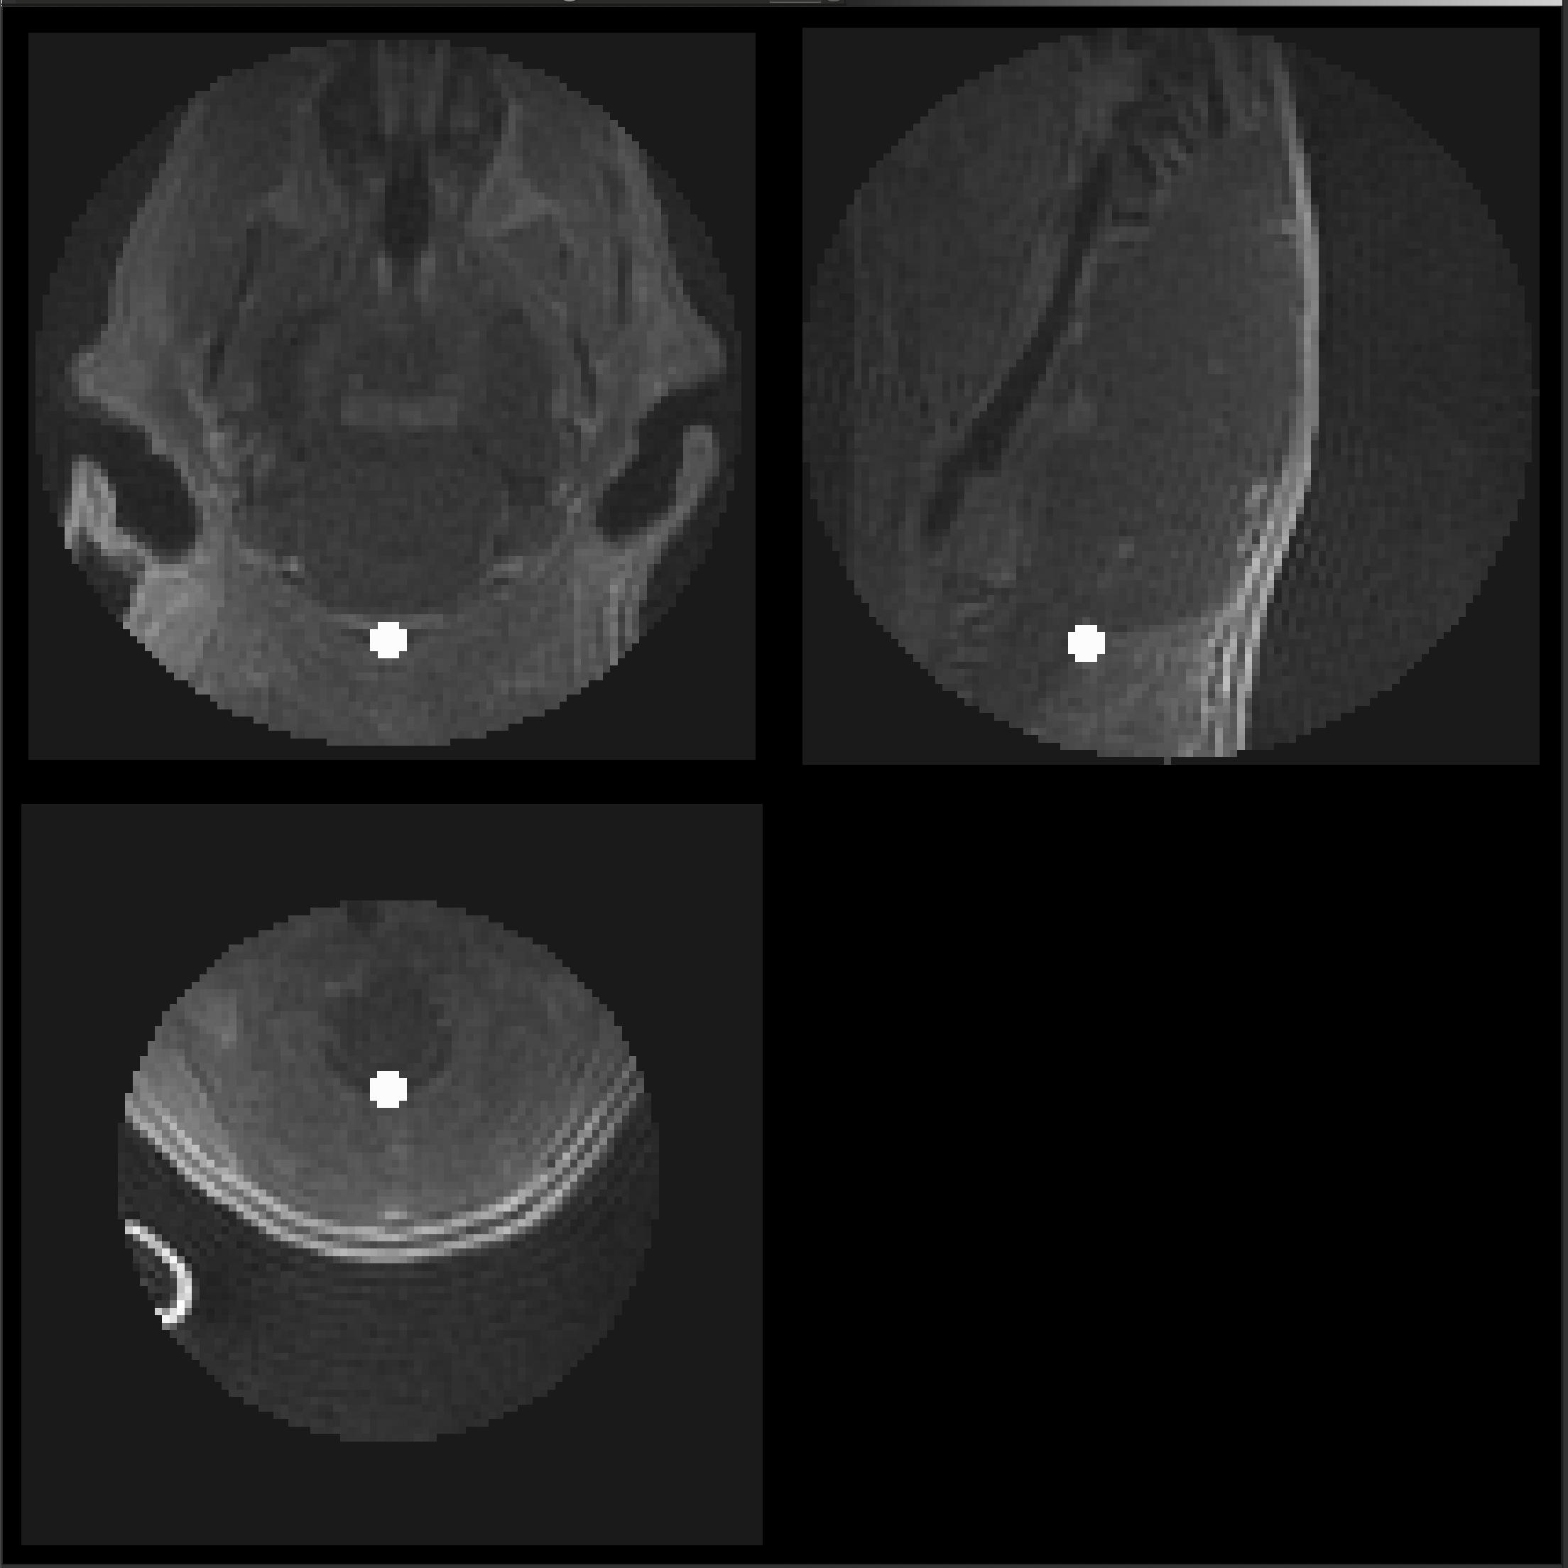
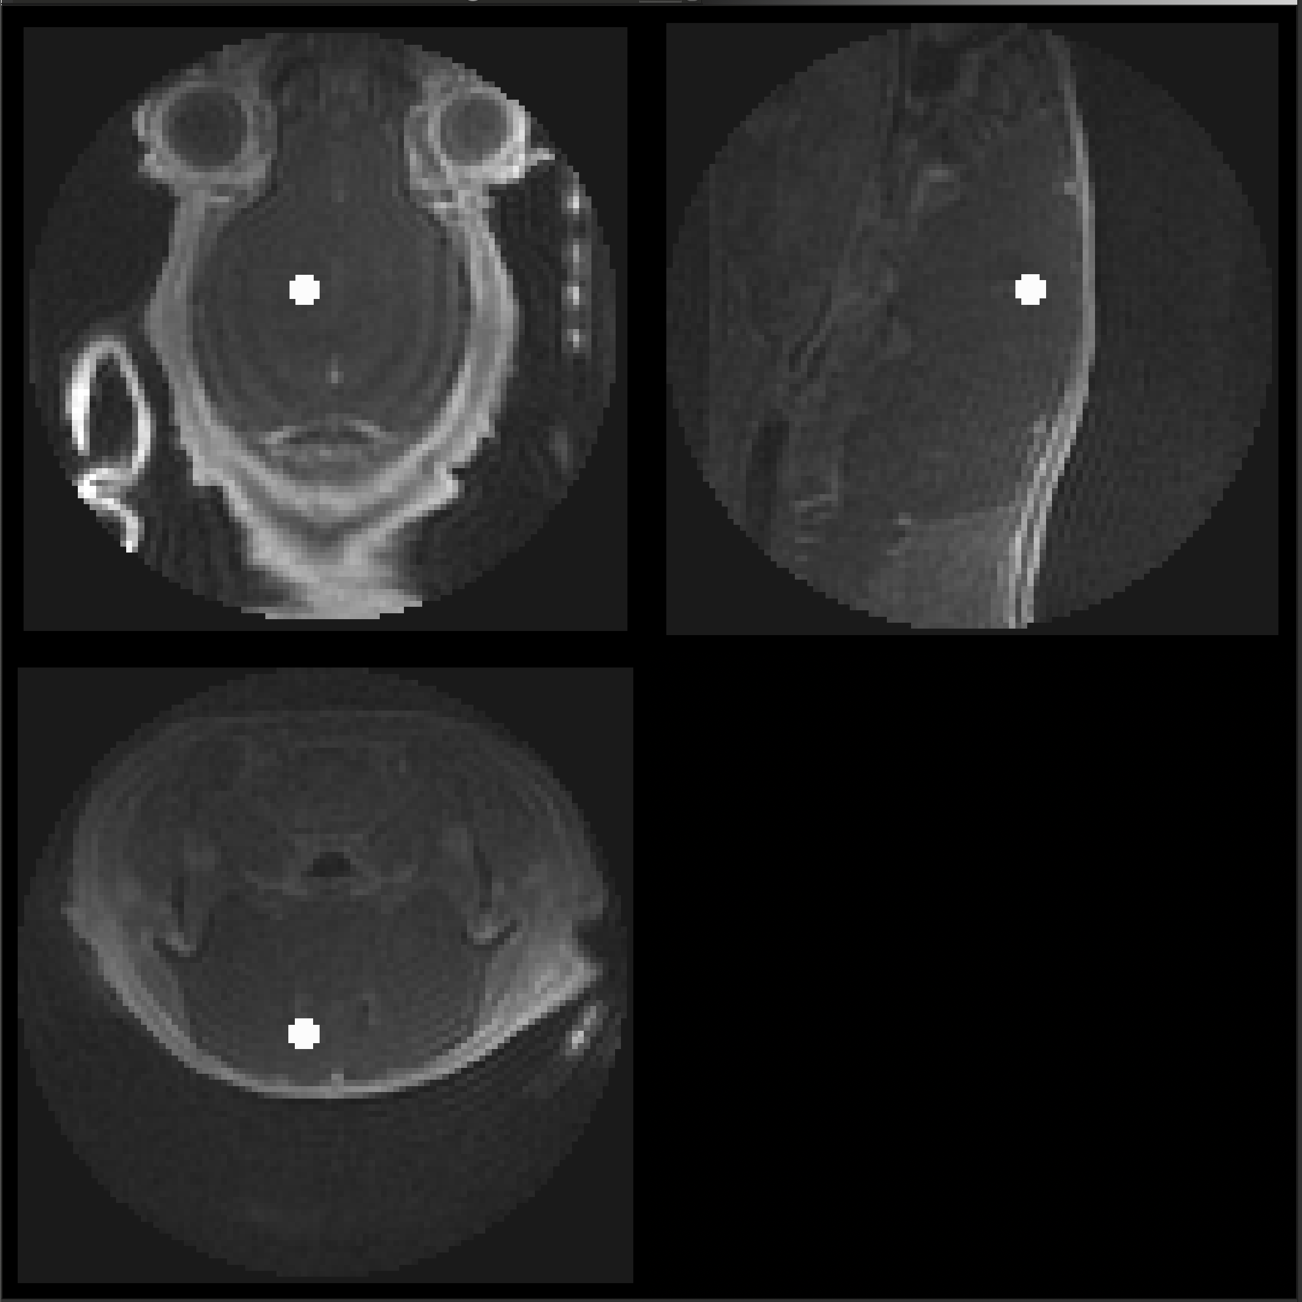
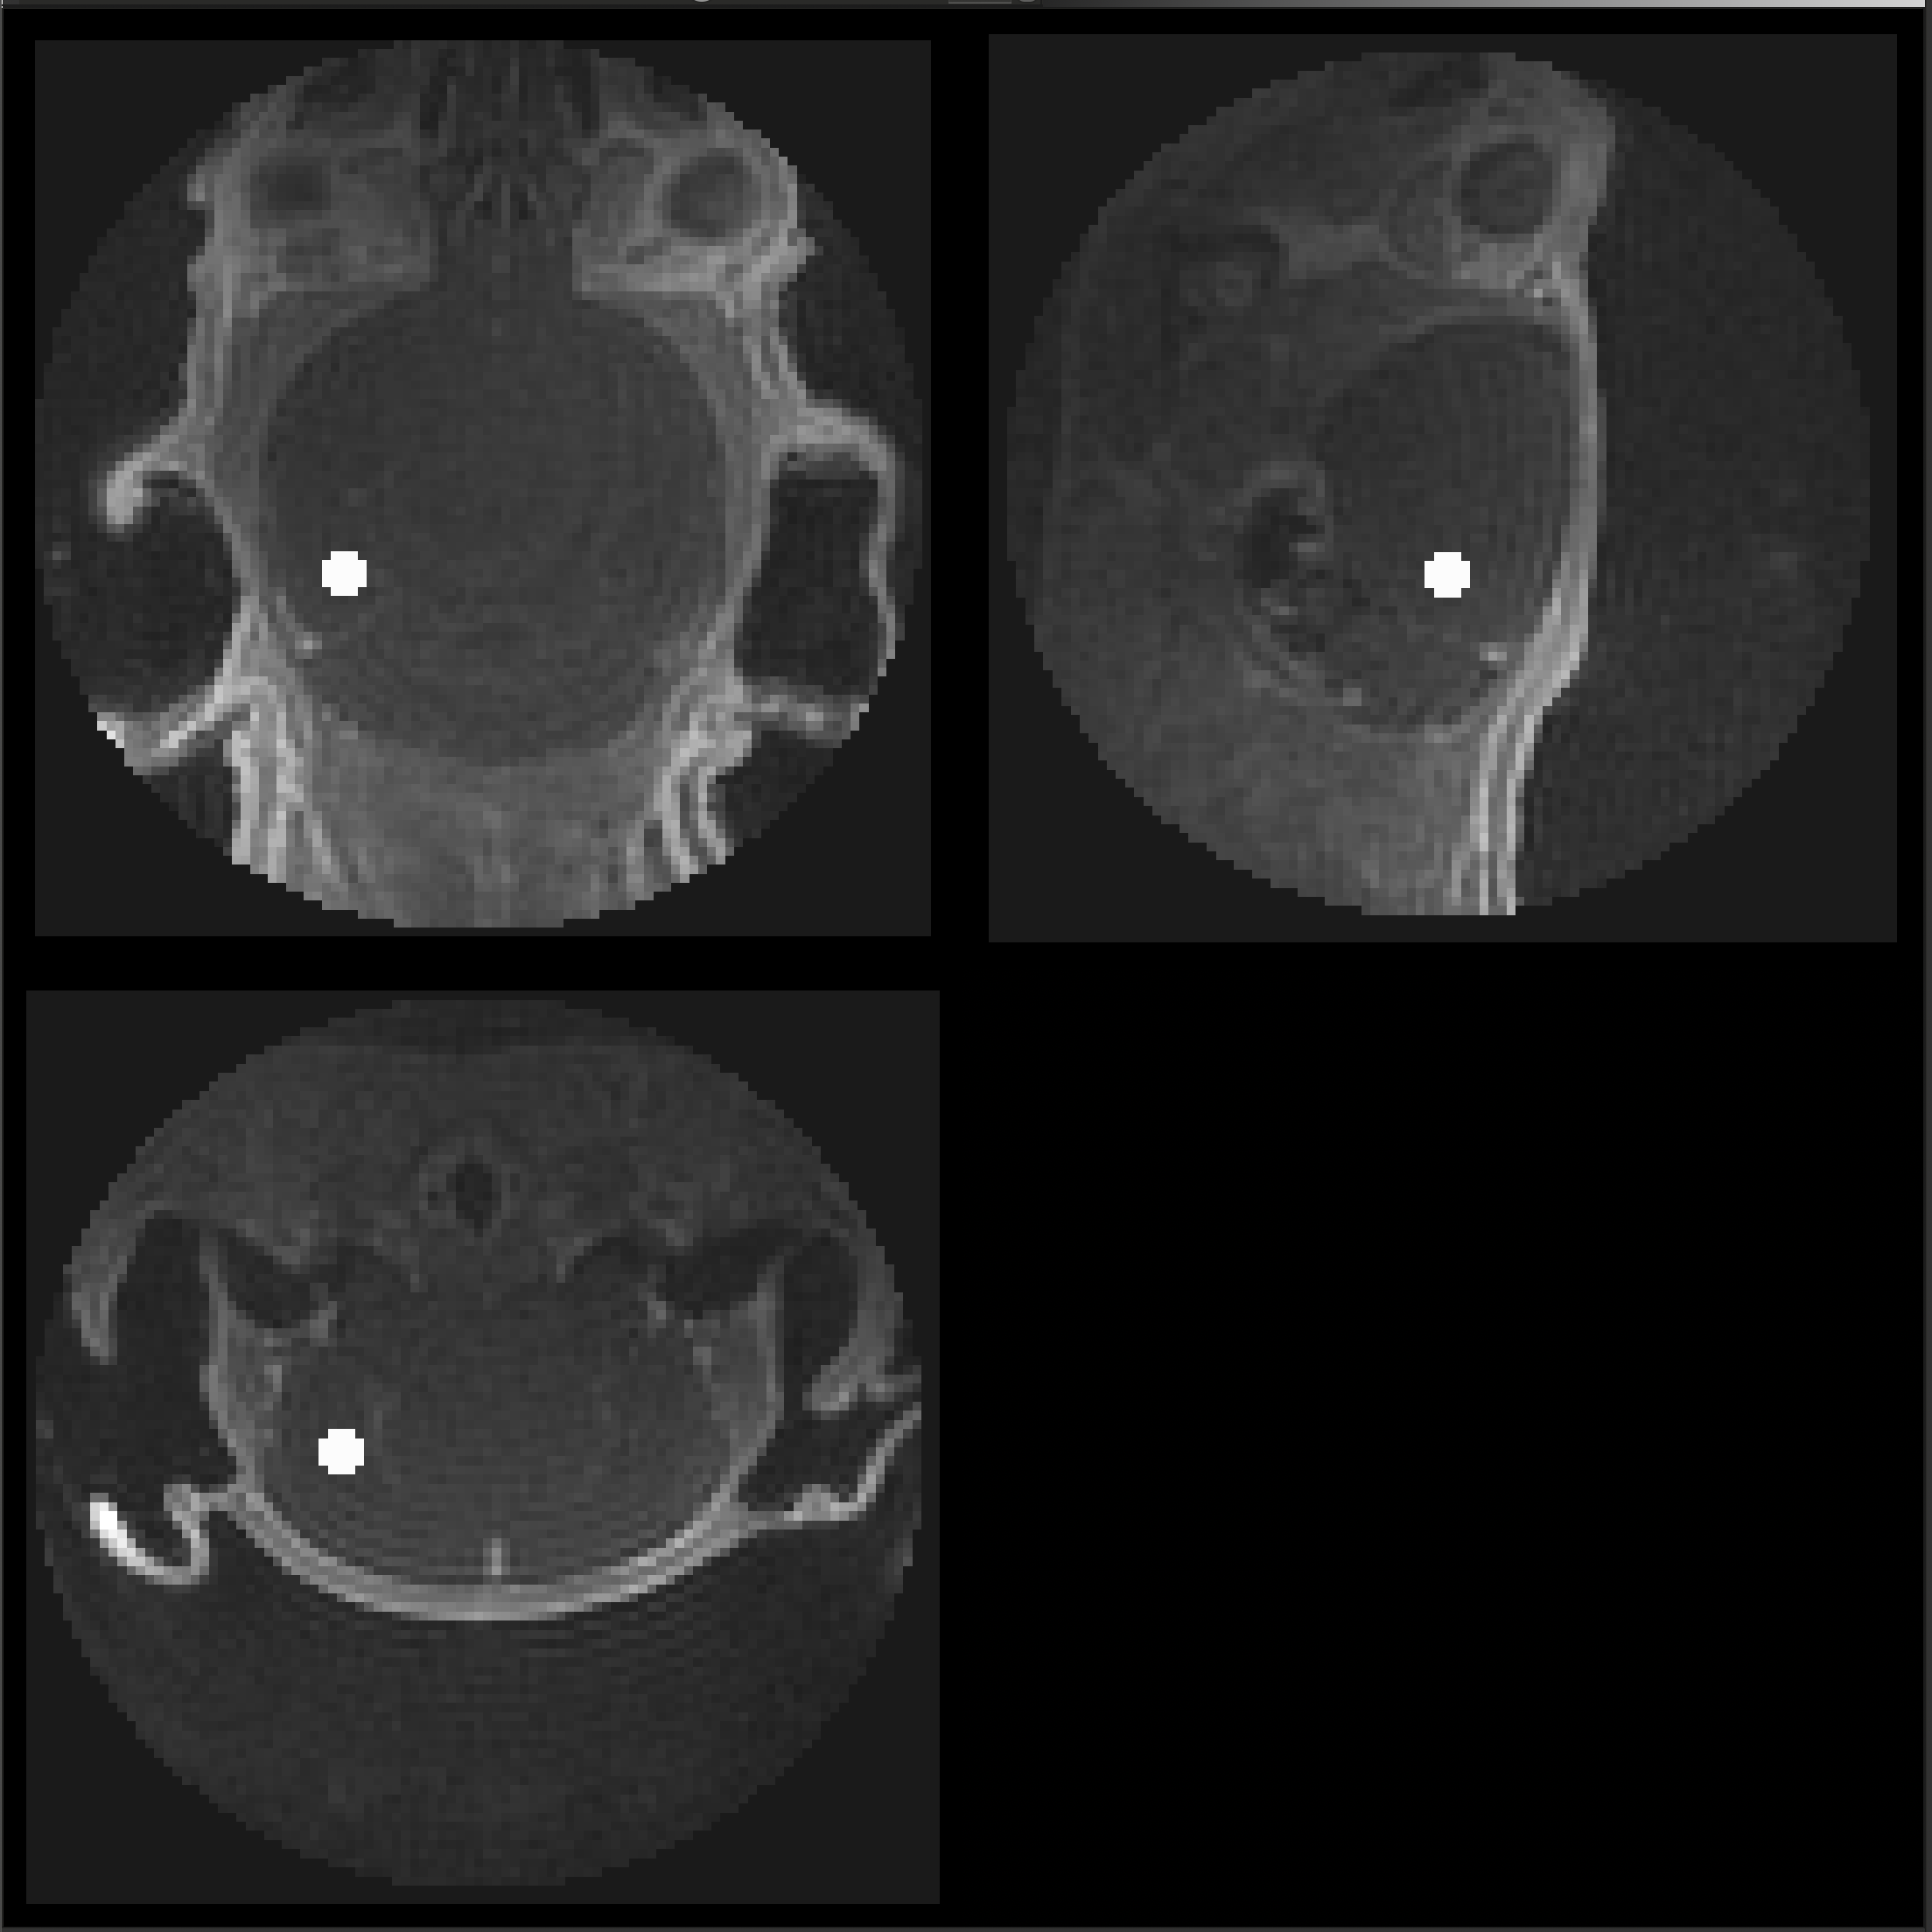
A26011601
Genotype: APOE
Method: IV
Usable: Yes
Cisterna Magna
Cerebral Spinal Fluid
Hippocampus

Slide 5
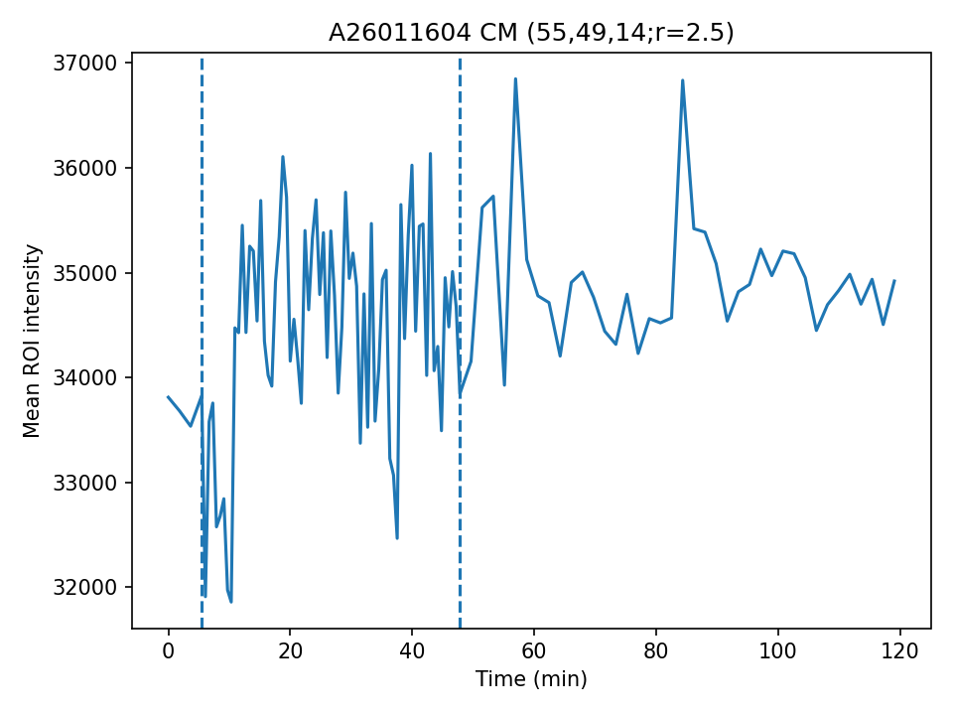
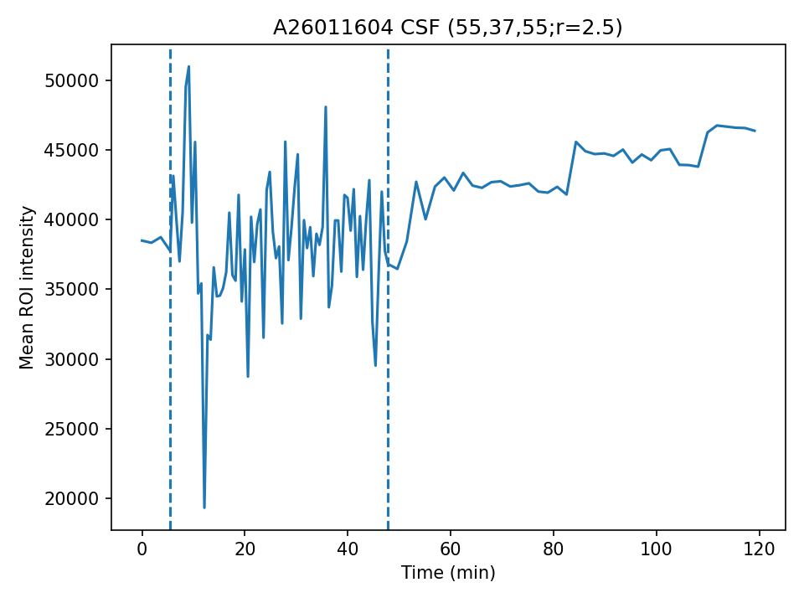
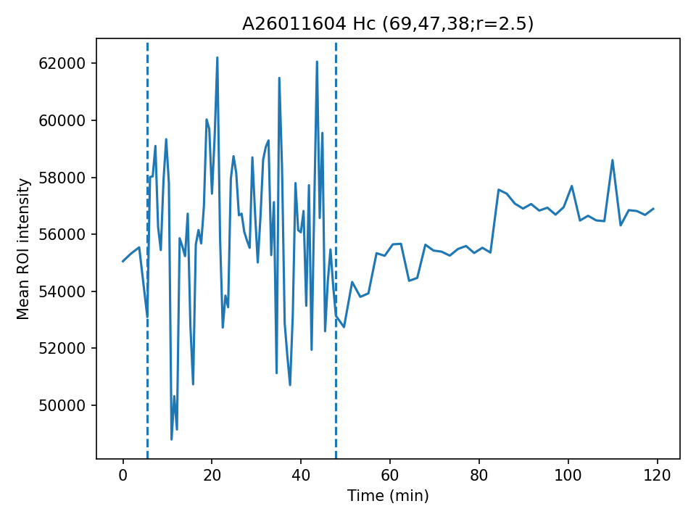
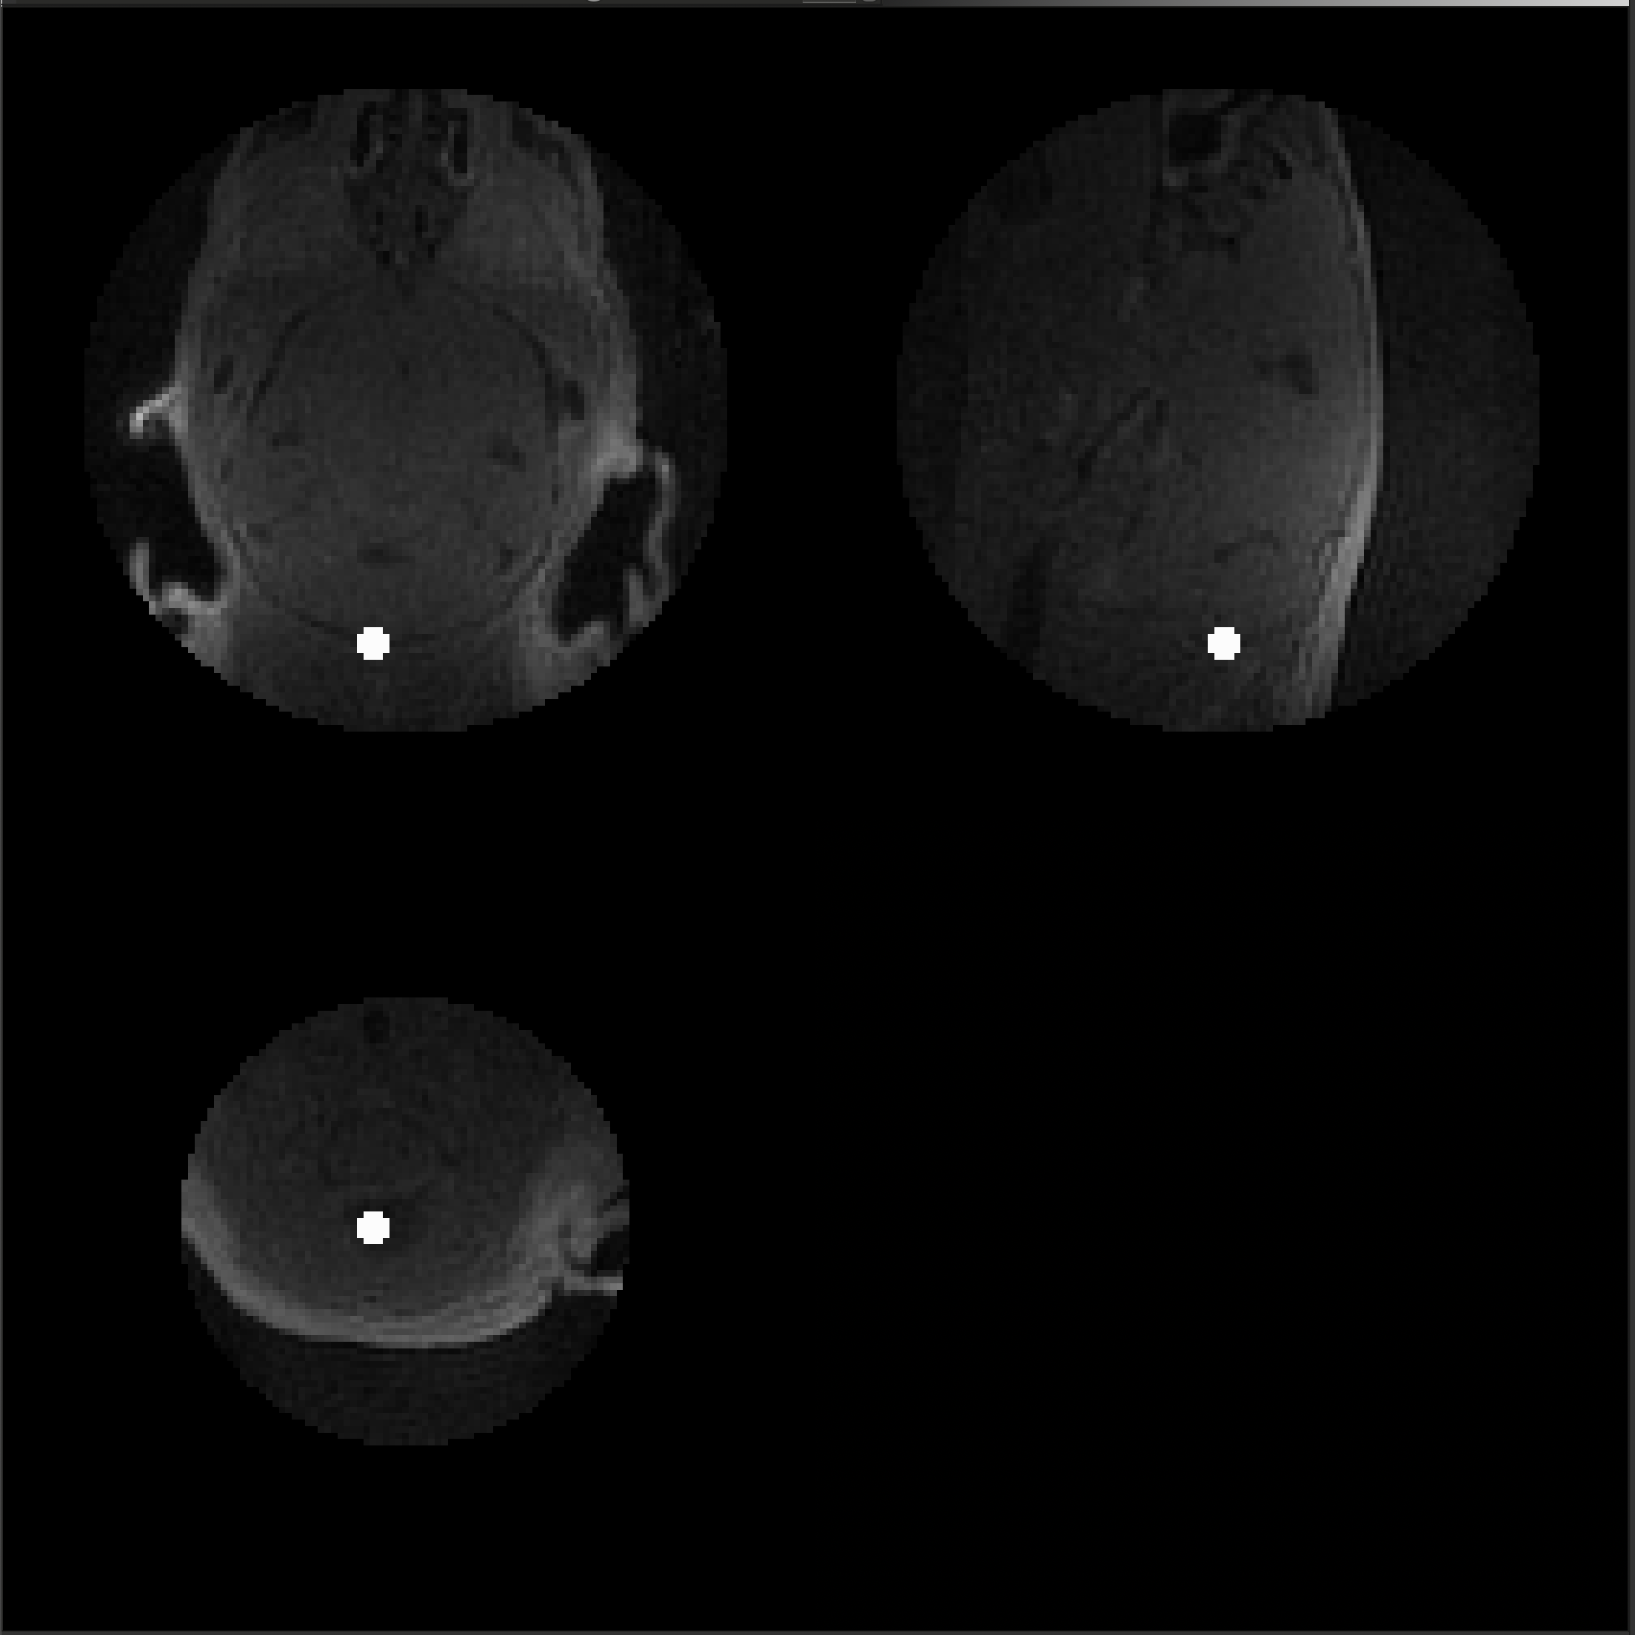
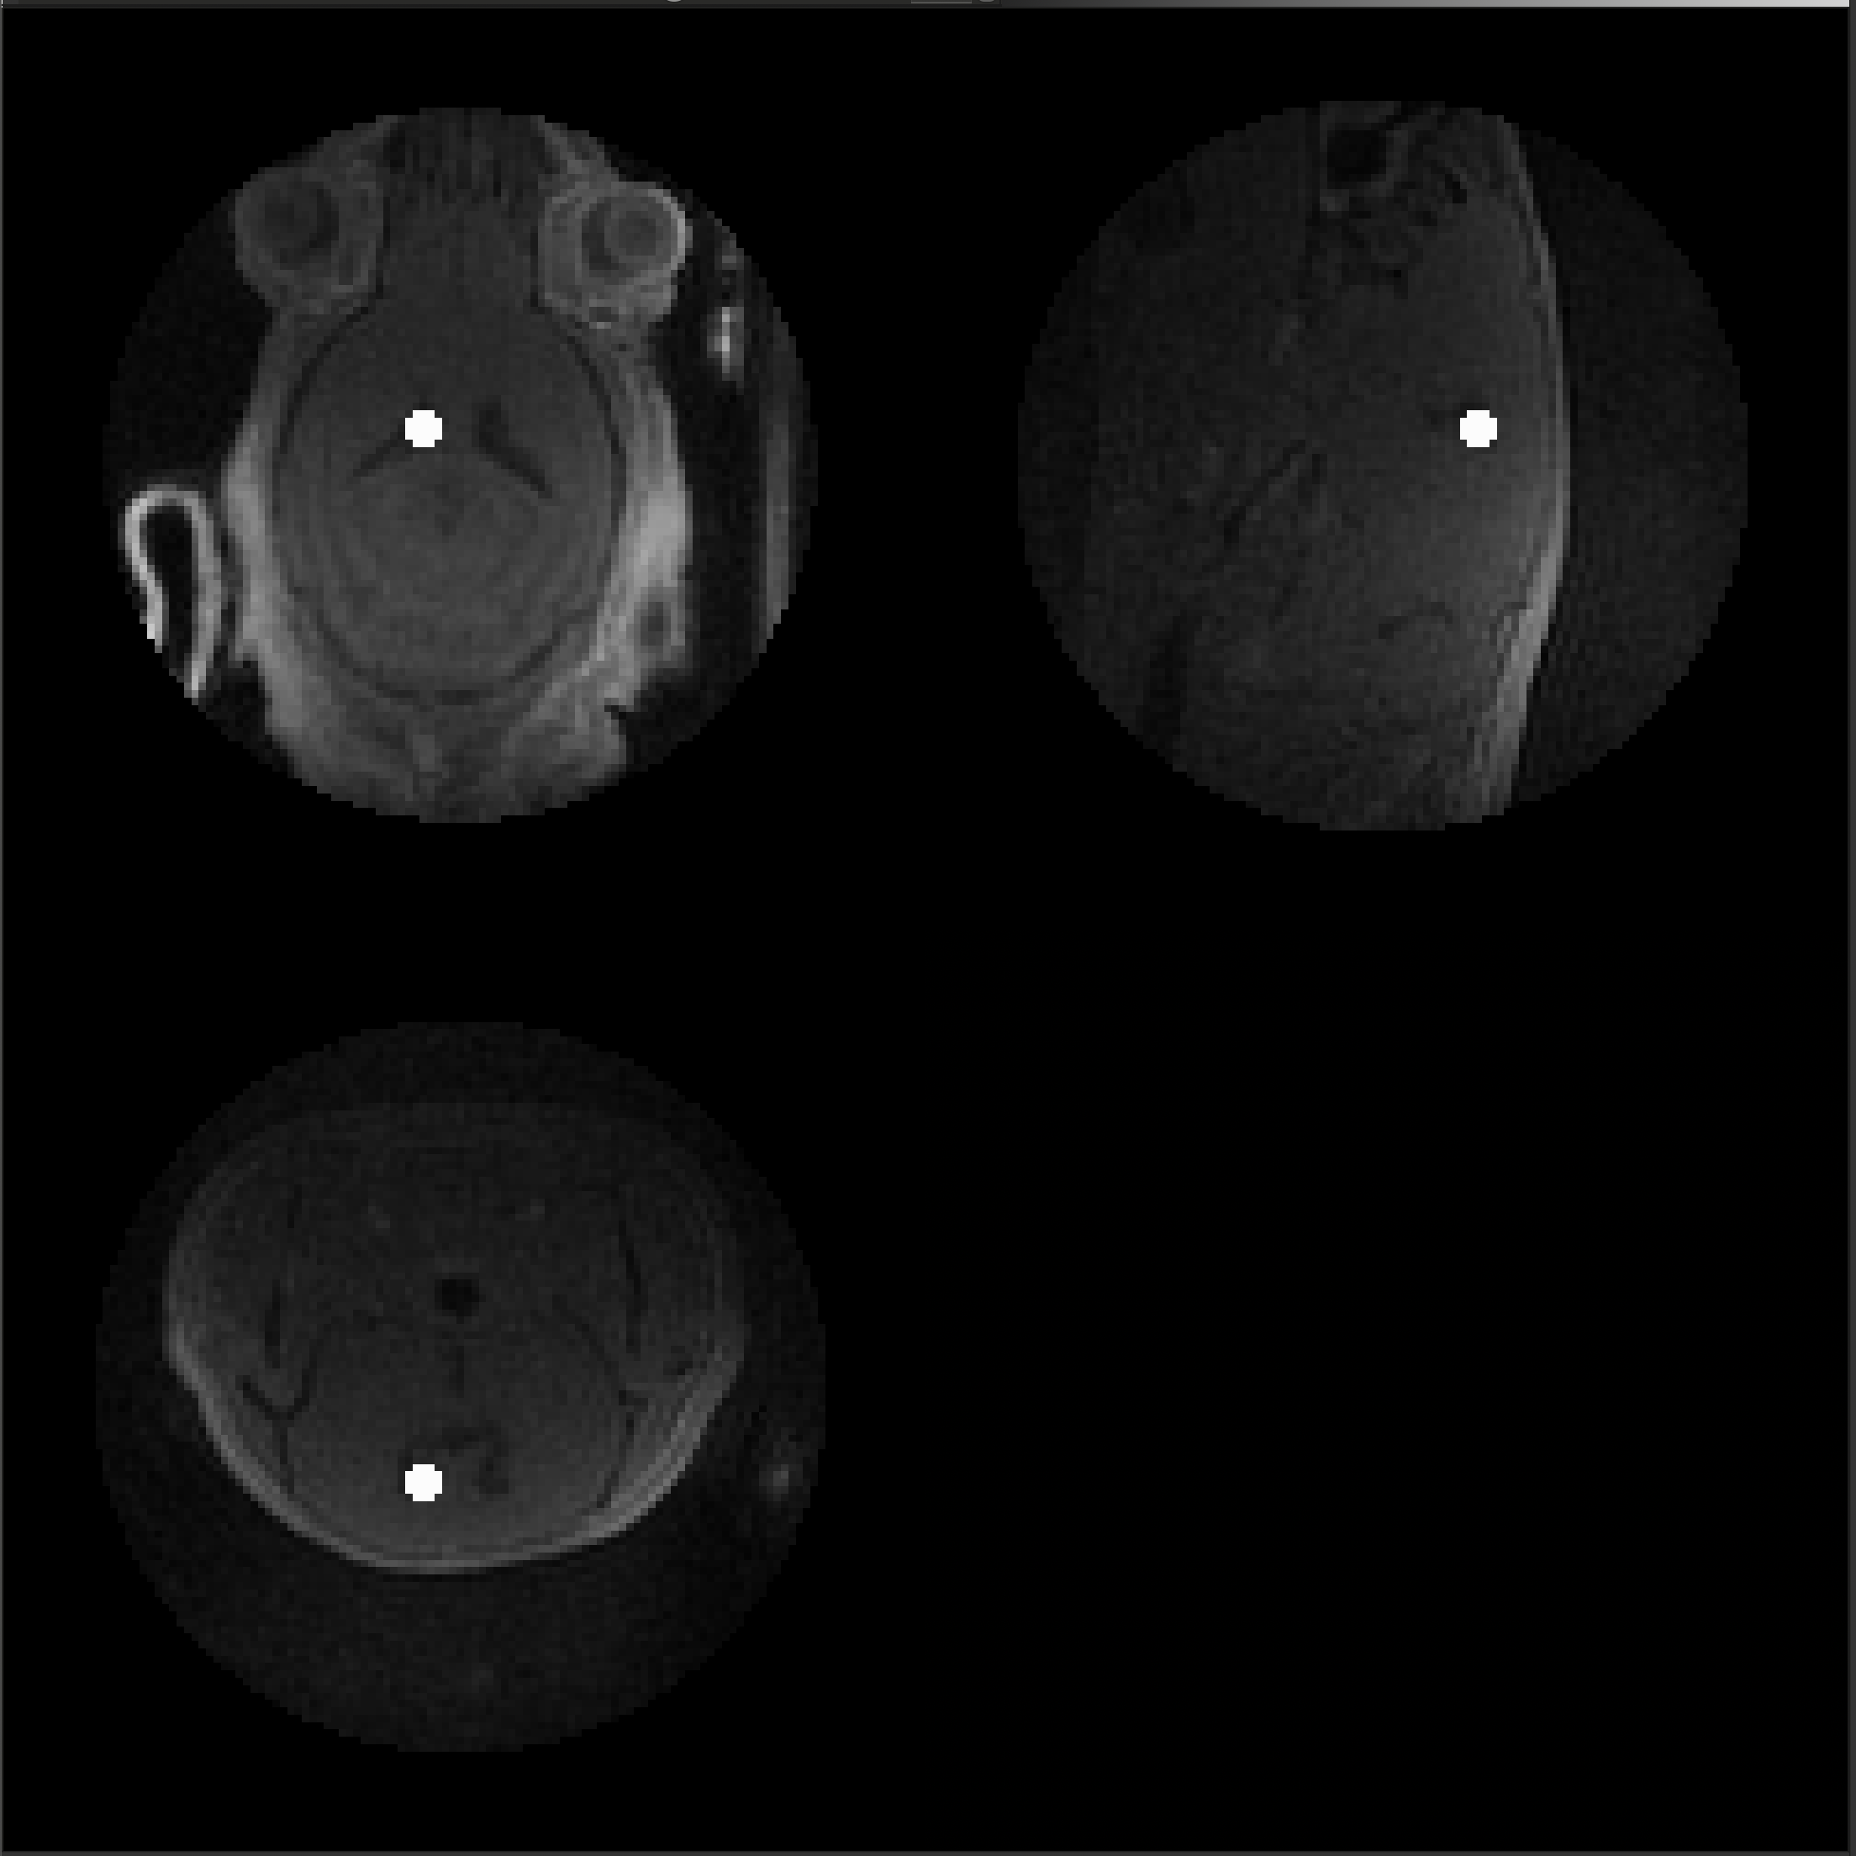
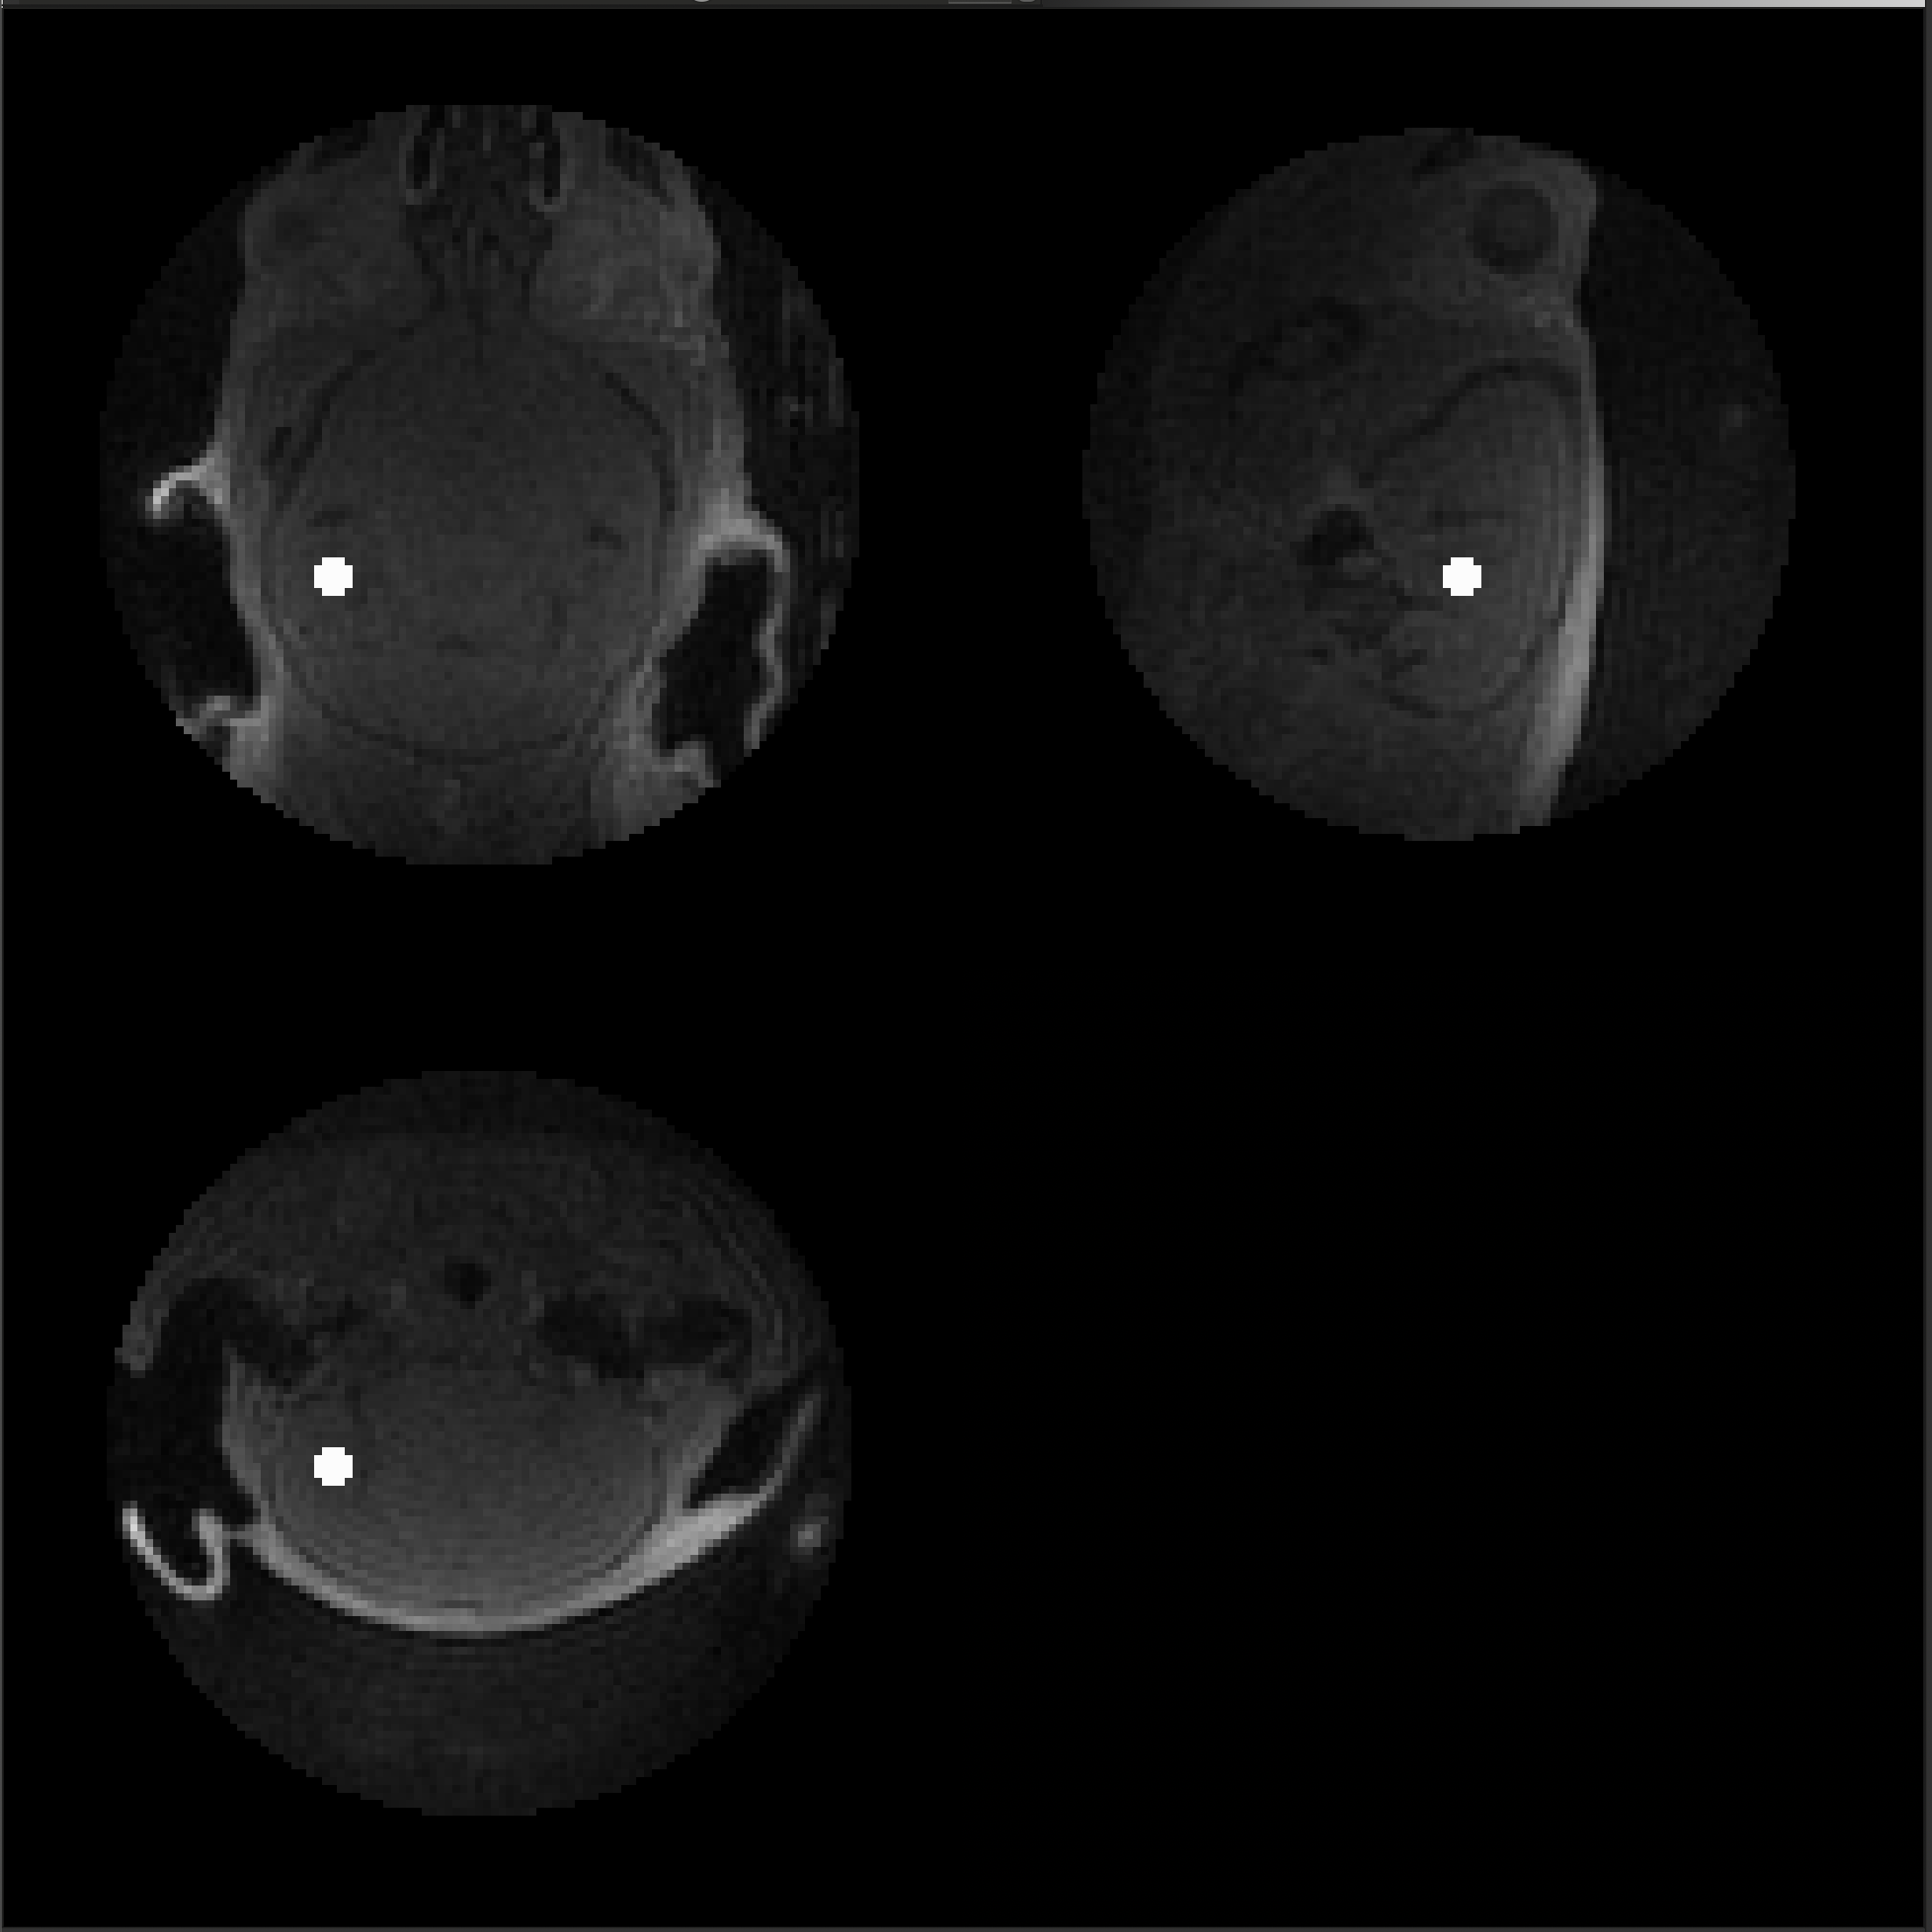
A26011604
Genotype: APOE
Method: IV
Usable: No
Cisterna Magna
Cerebral Spinal Fluid
Hippocampus

Slide 6
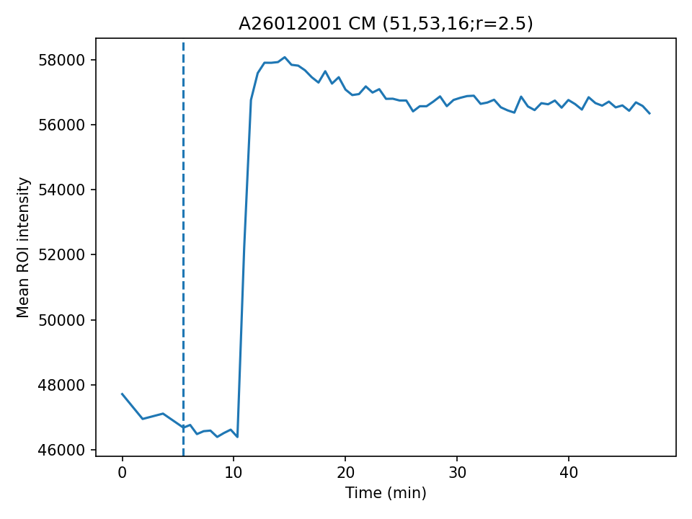
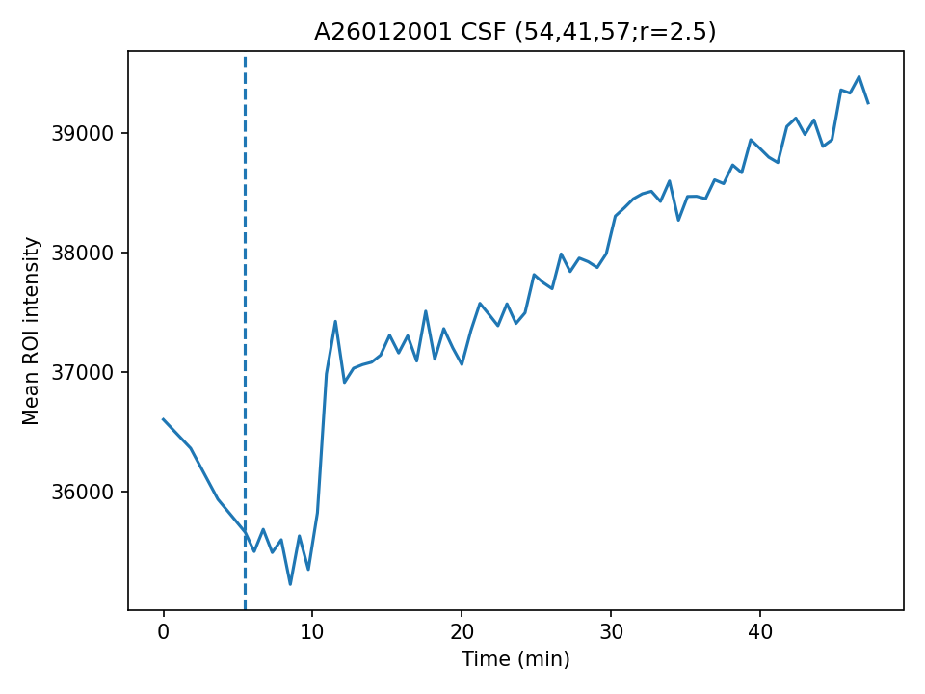
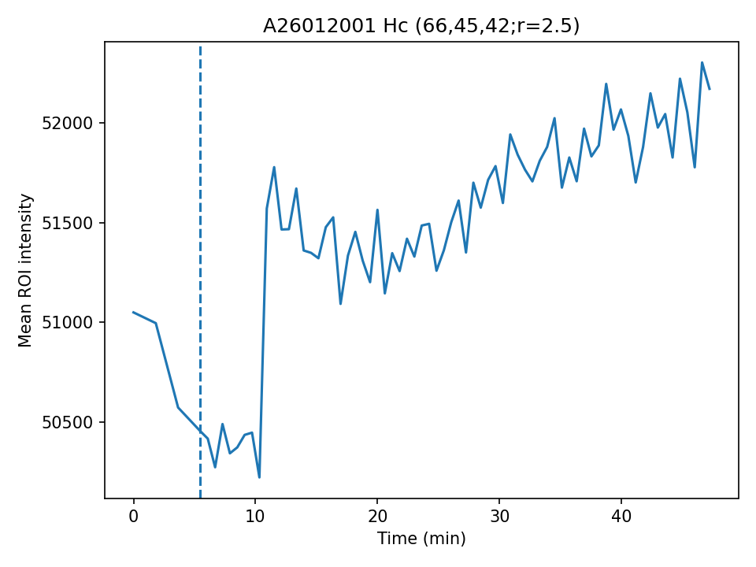
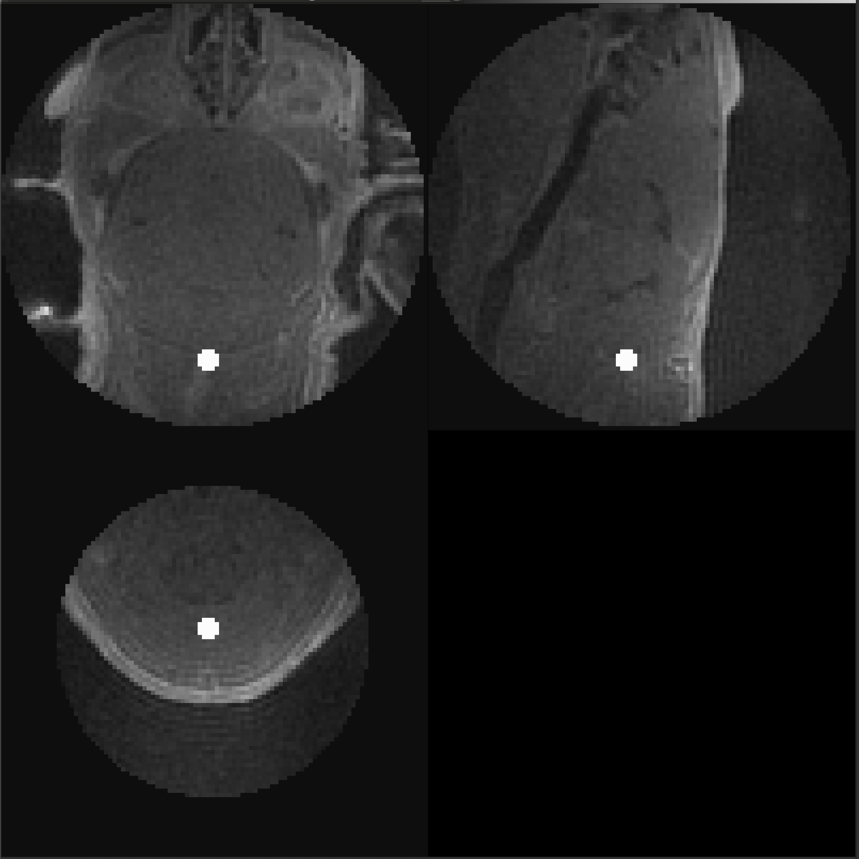
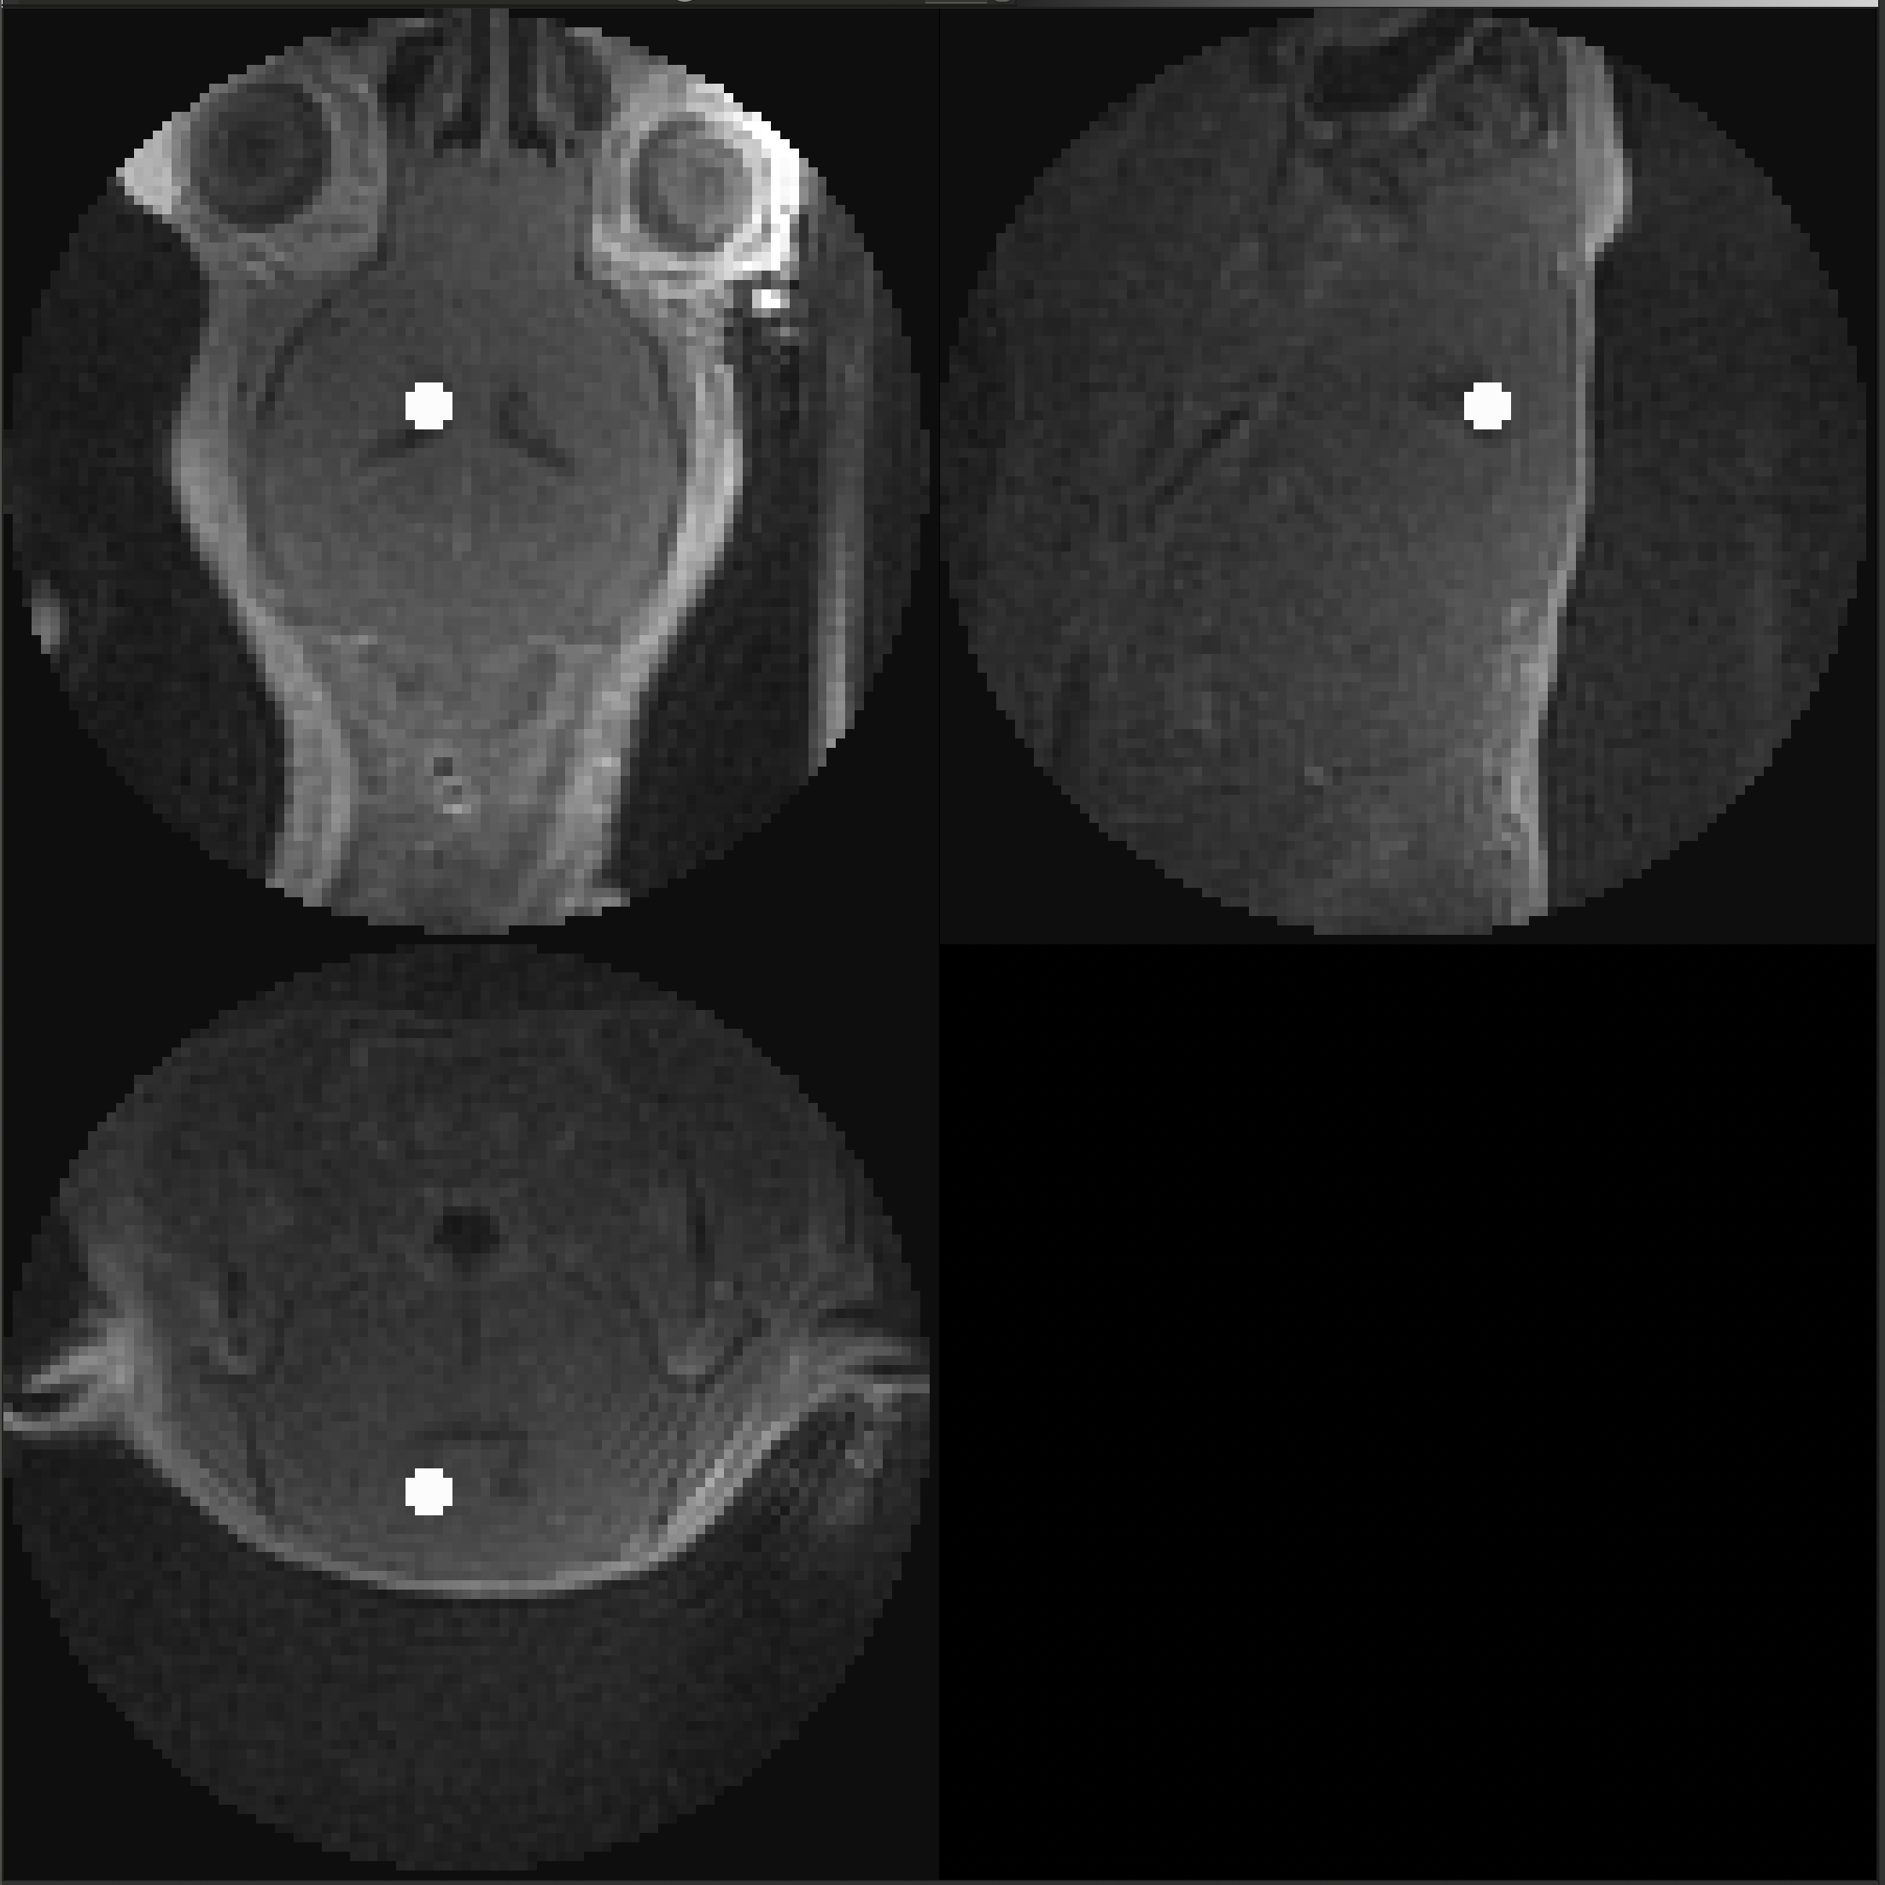
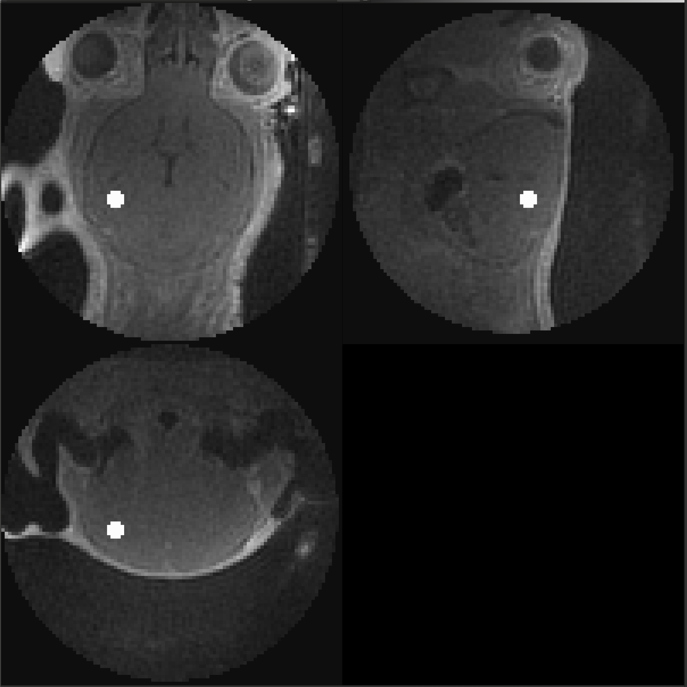
A26012001
Genotype: APOE
Method: IV
Usable: Yes
Cisterna Magna
Cerebral Spinal Fluid
Hippocampus

Slide 7
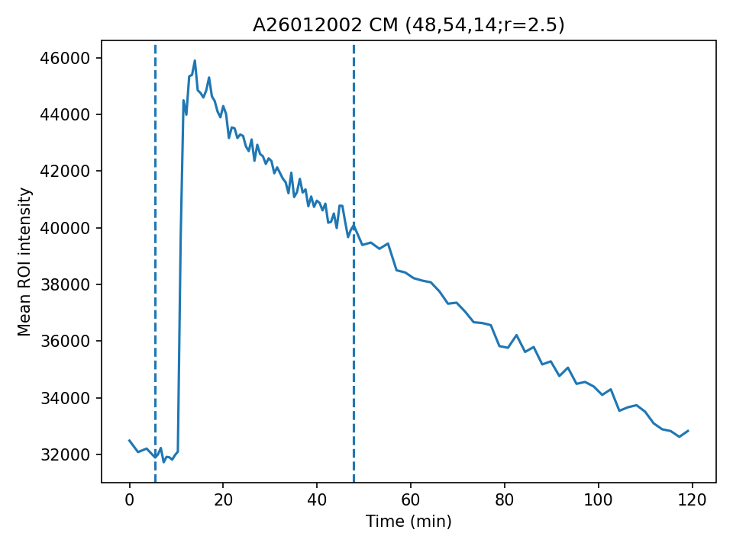
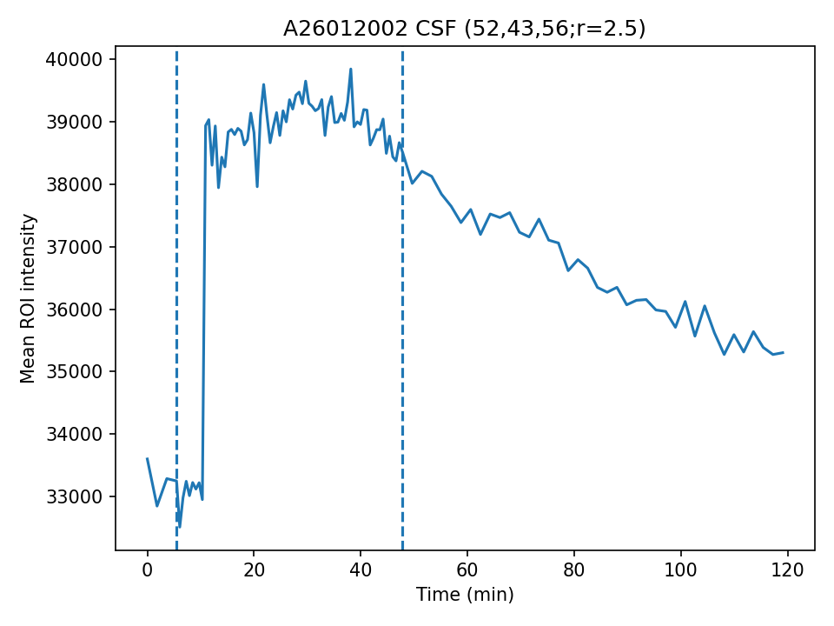
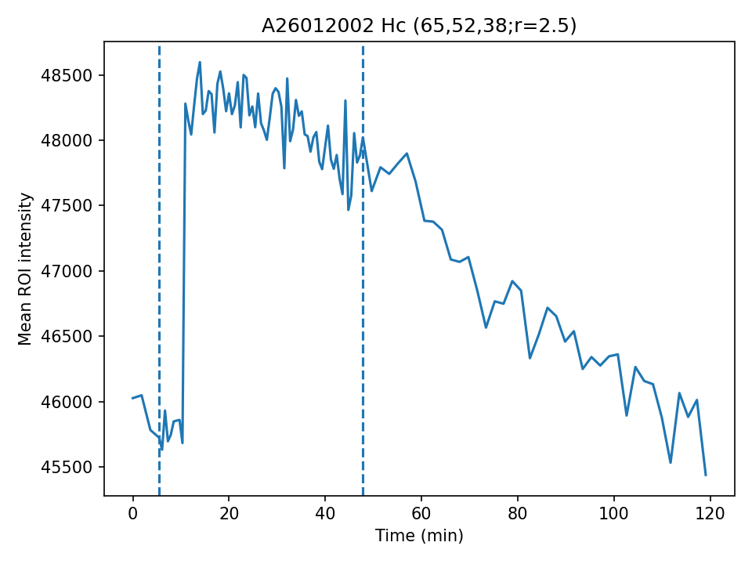
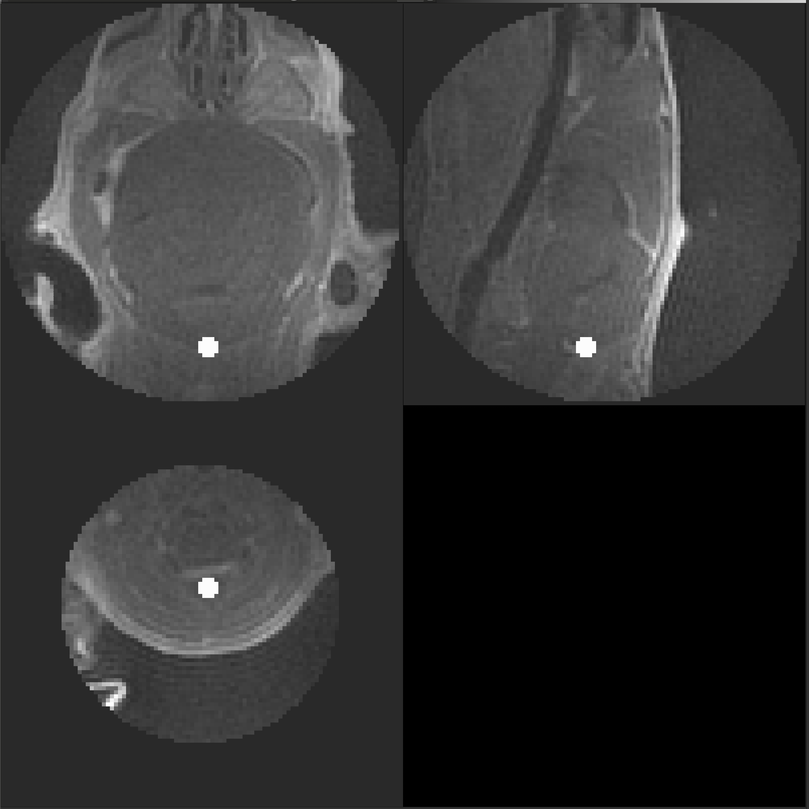
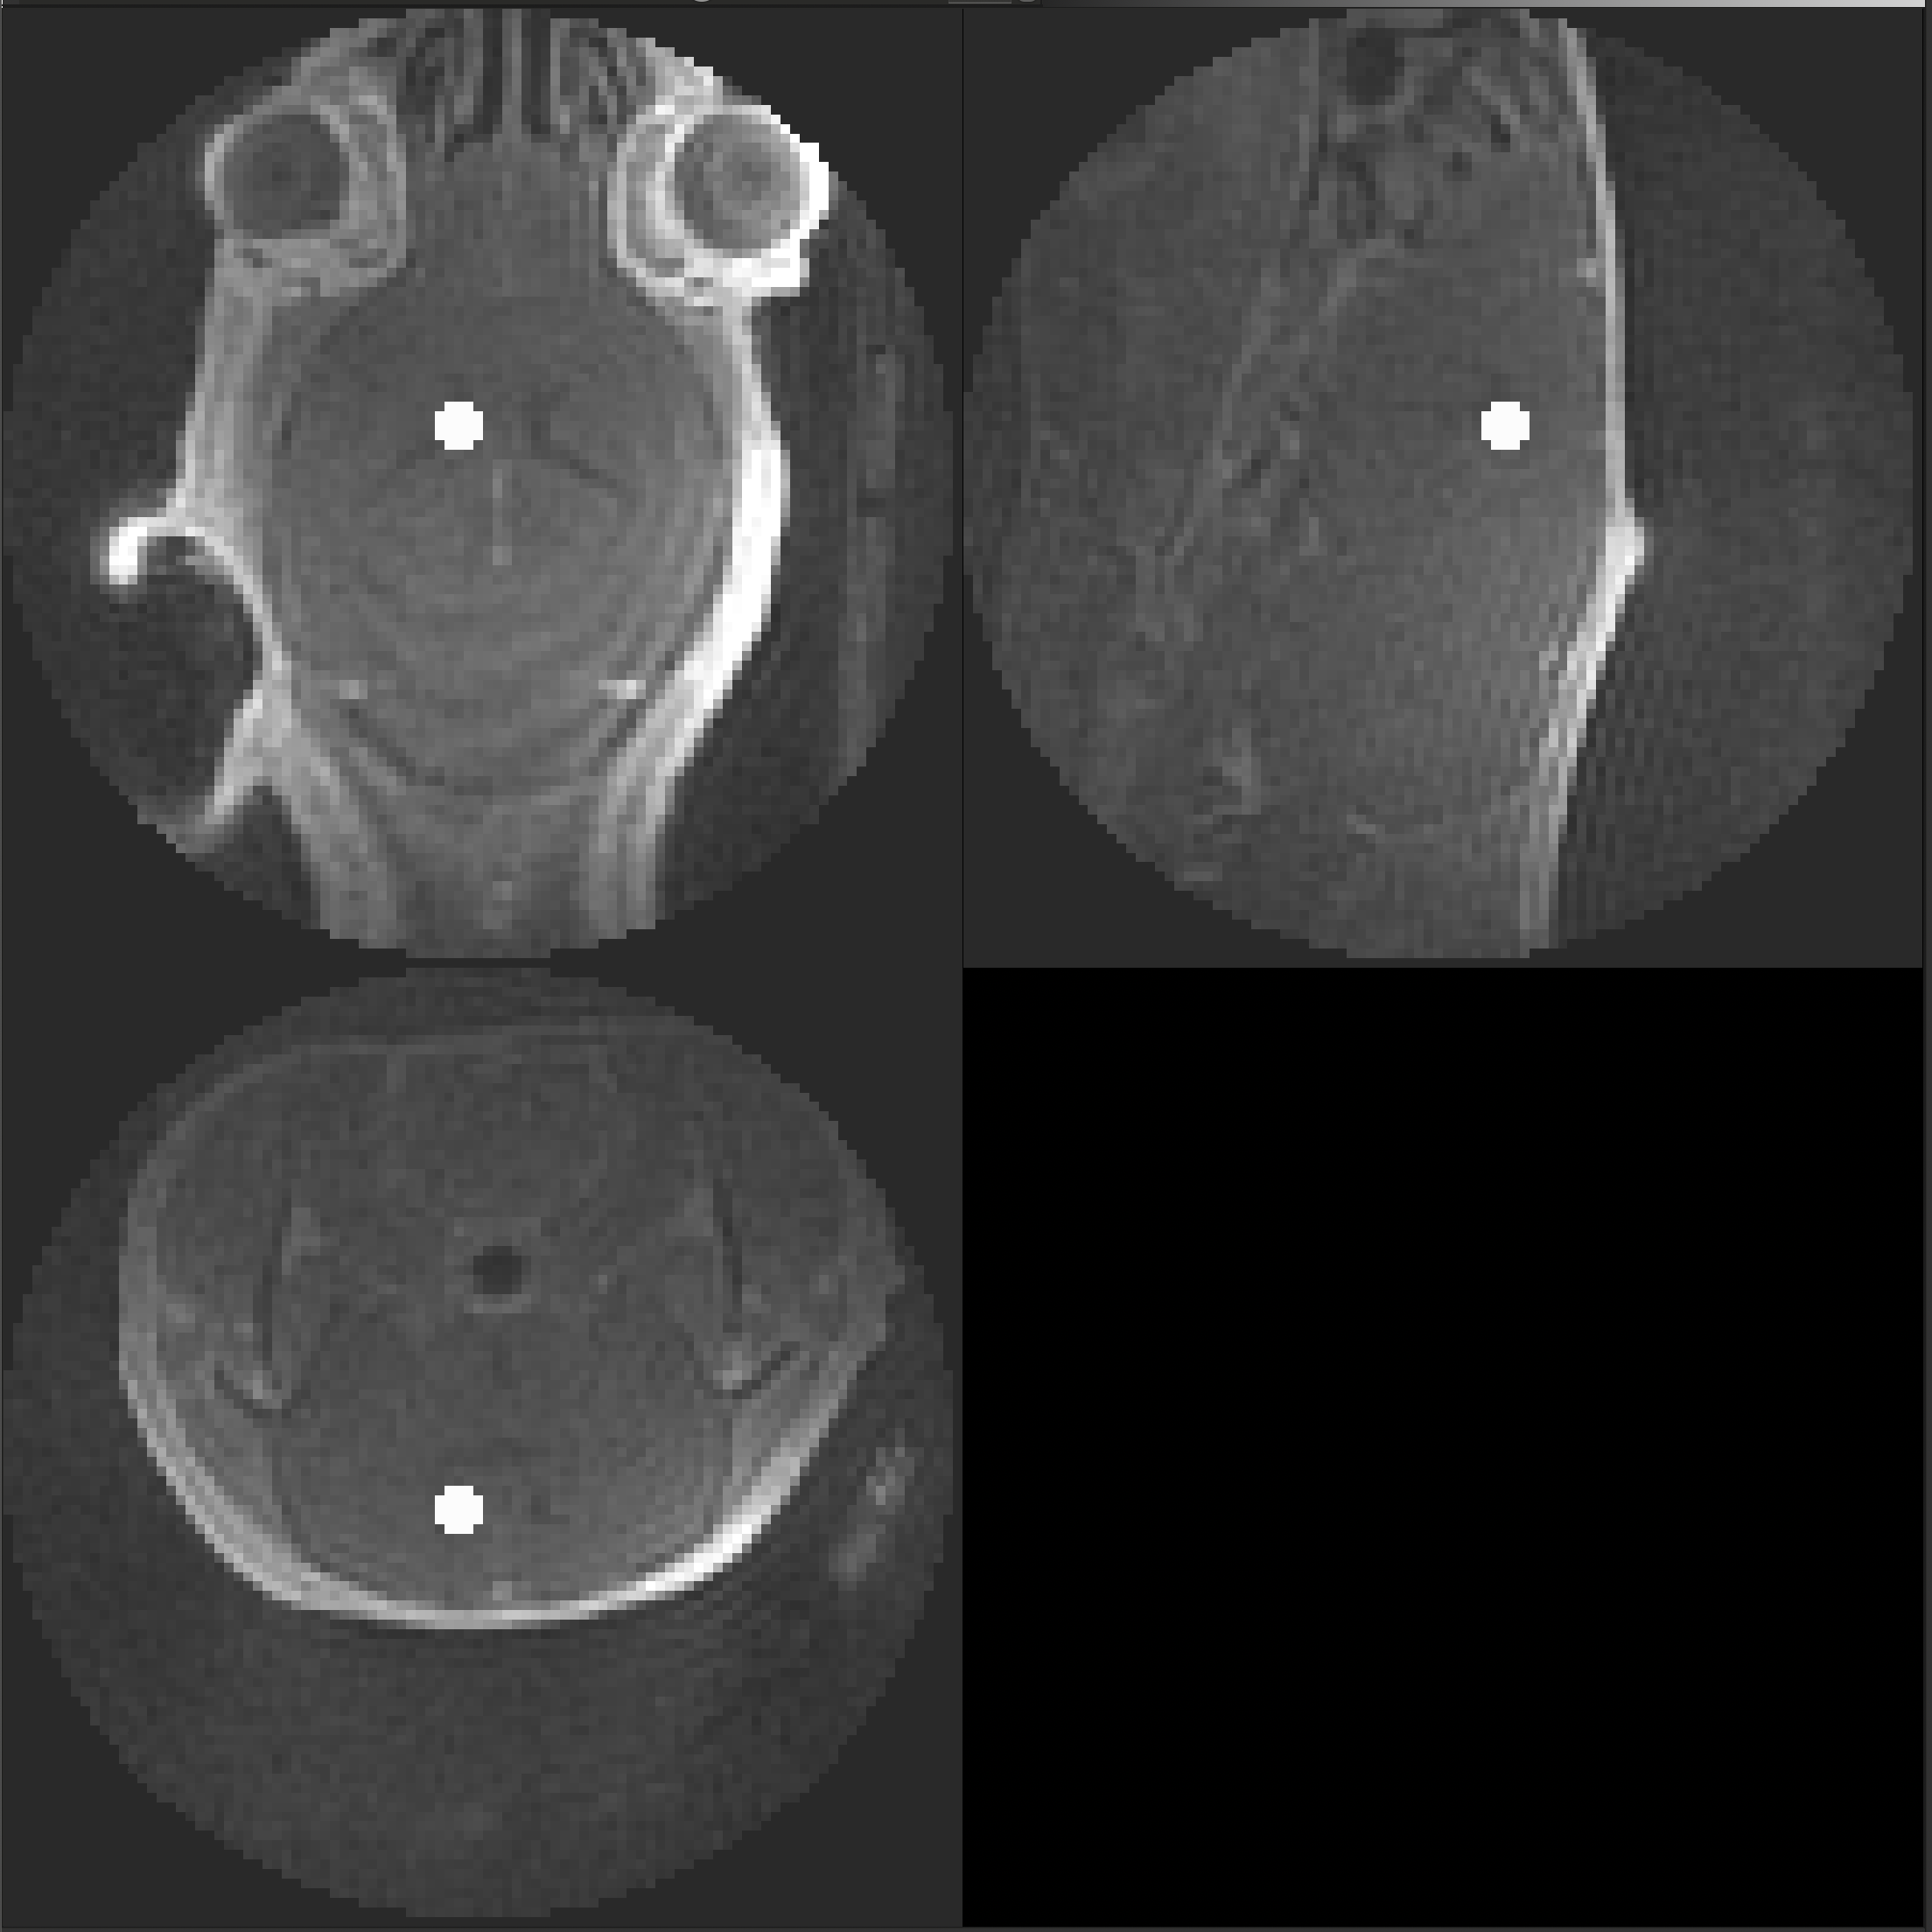
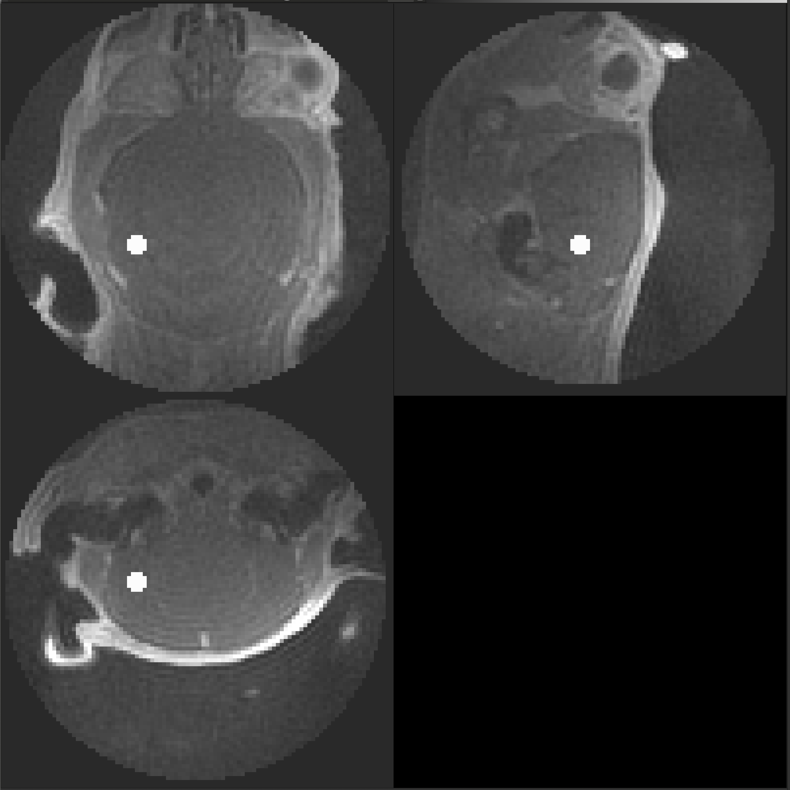
A26012002
Genotype: APOE
Method: IV
Usable: Yes
Cisterna Magna
Cerebral Spinal Fluid
Hippocampus

Slide 8
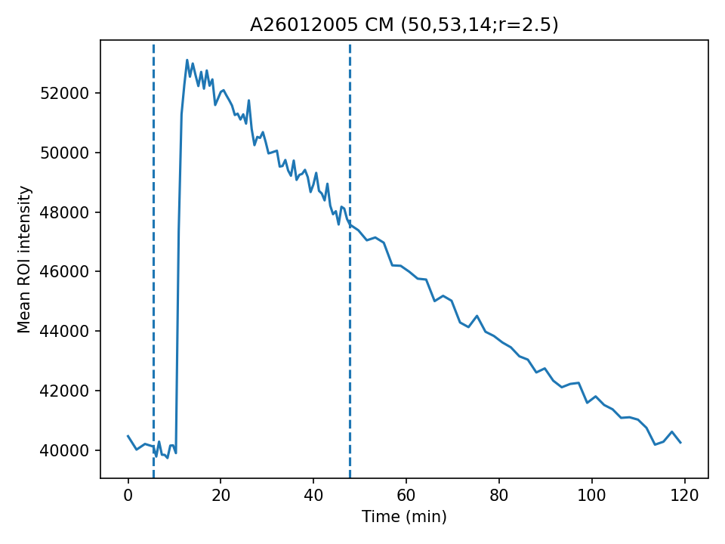
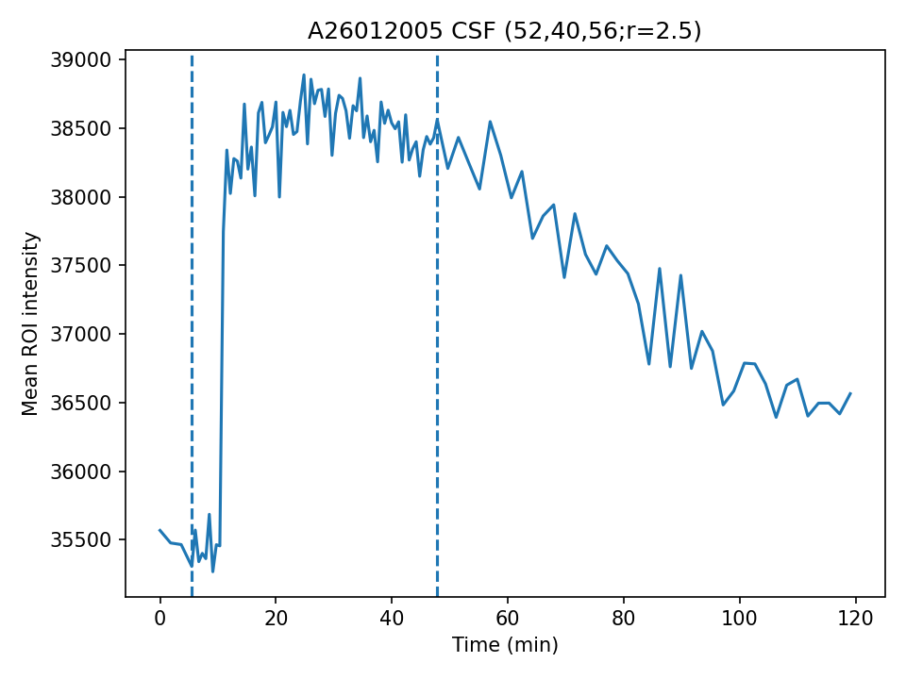
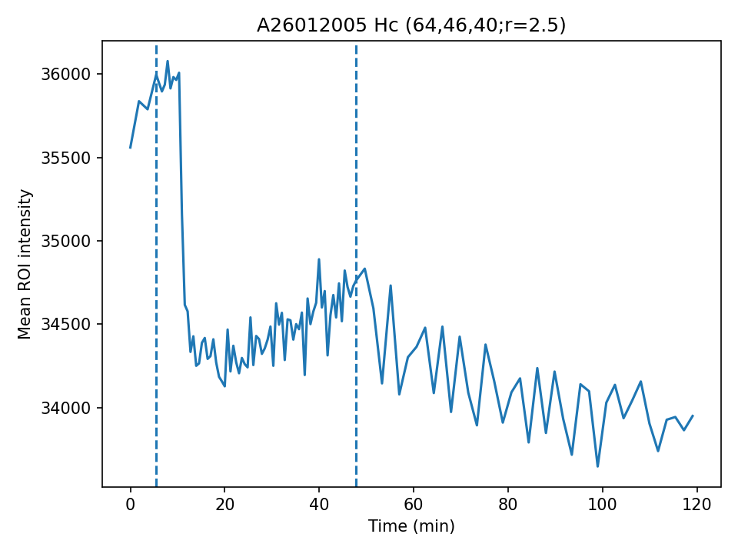
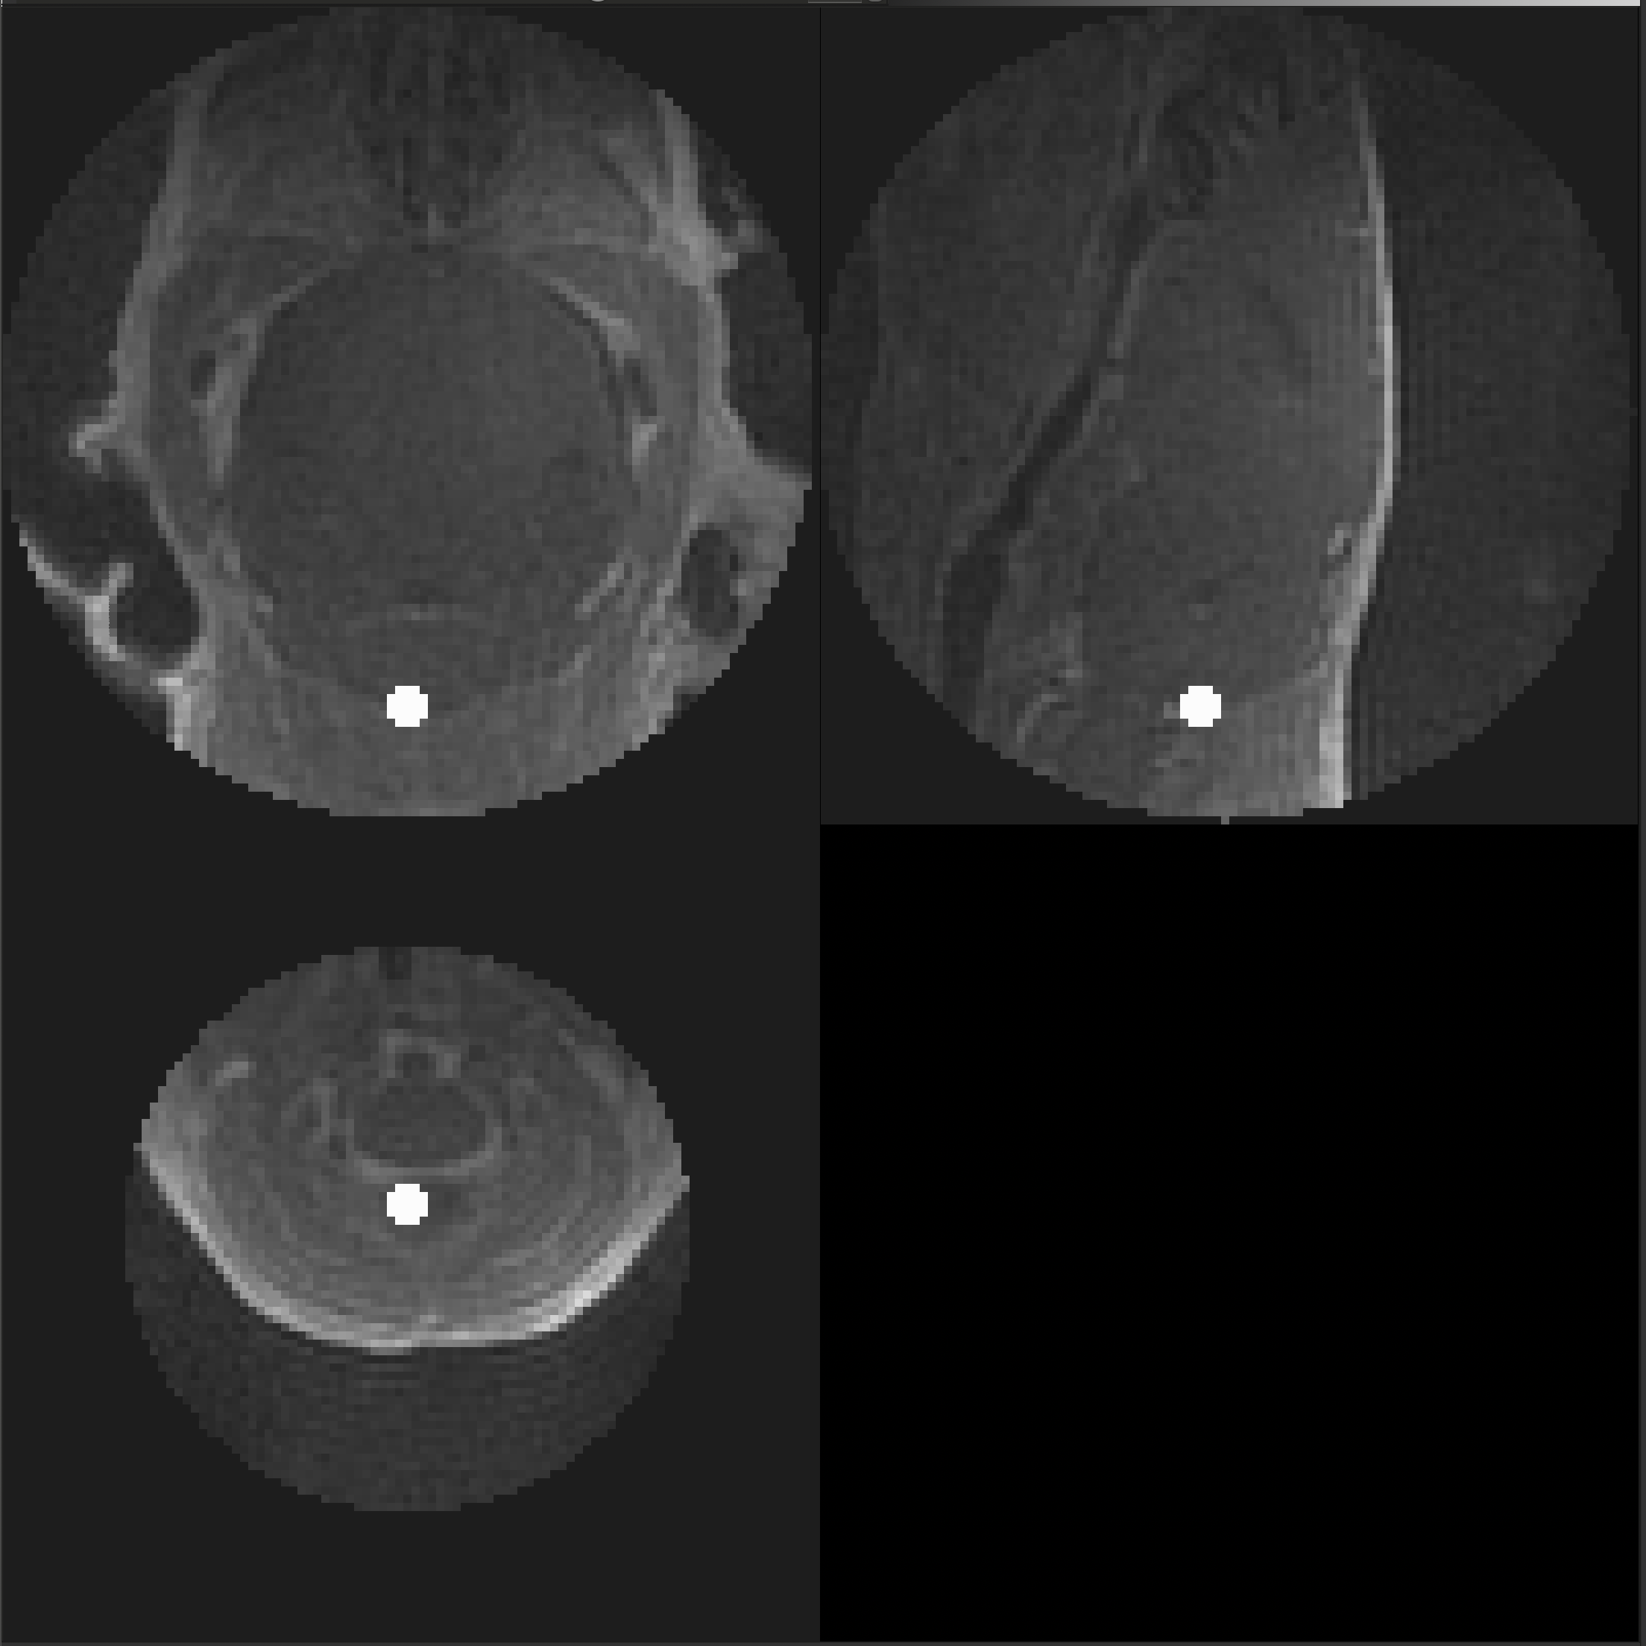
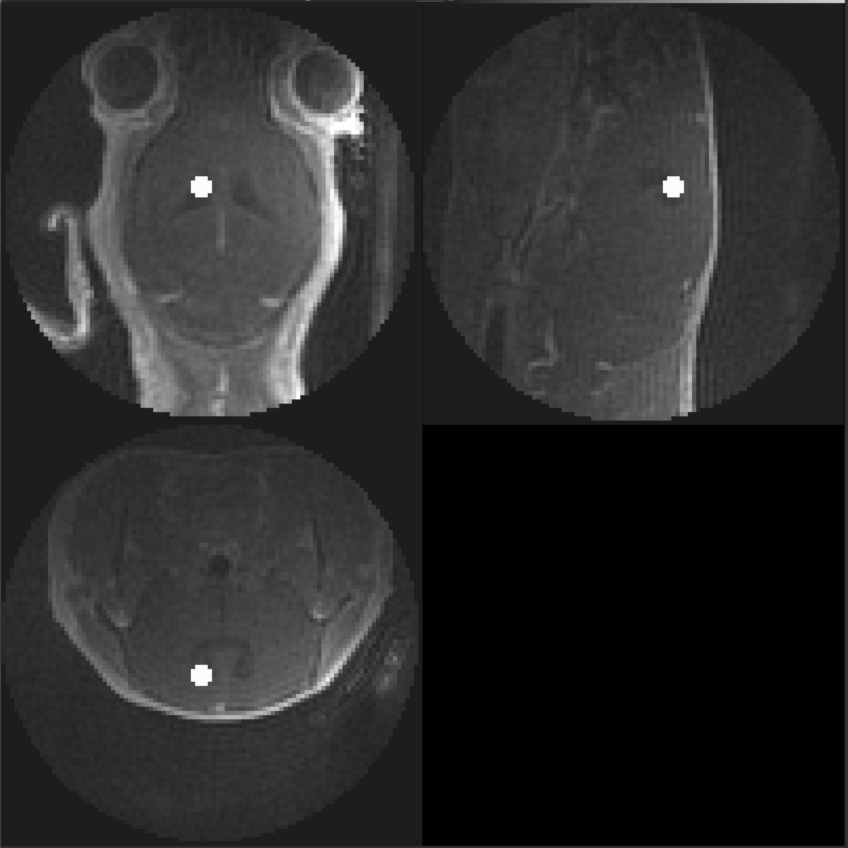
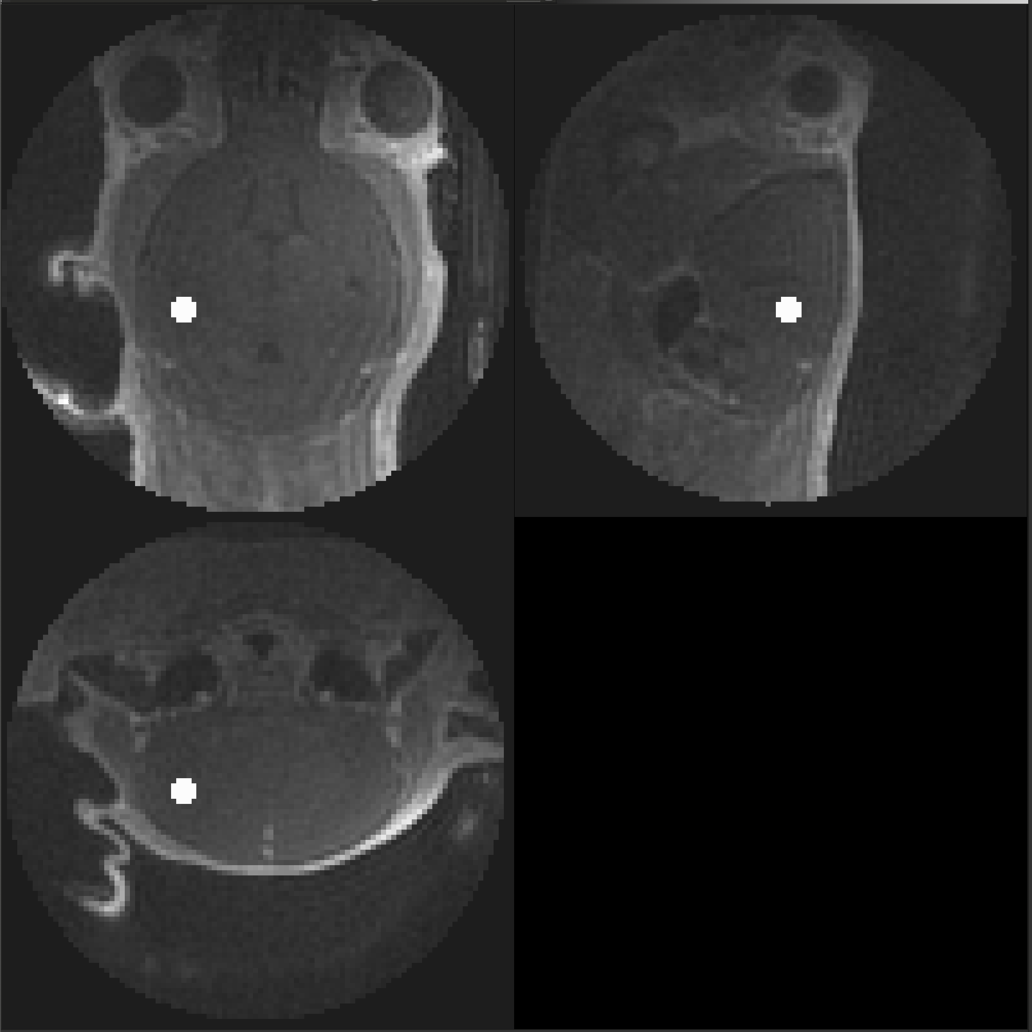
A26012005
Genotype: APOE
Method: IV
Usable: Yes
Cisterna Magna
Cerebral Spinal Fluid
Hippocampus

Slide 9
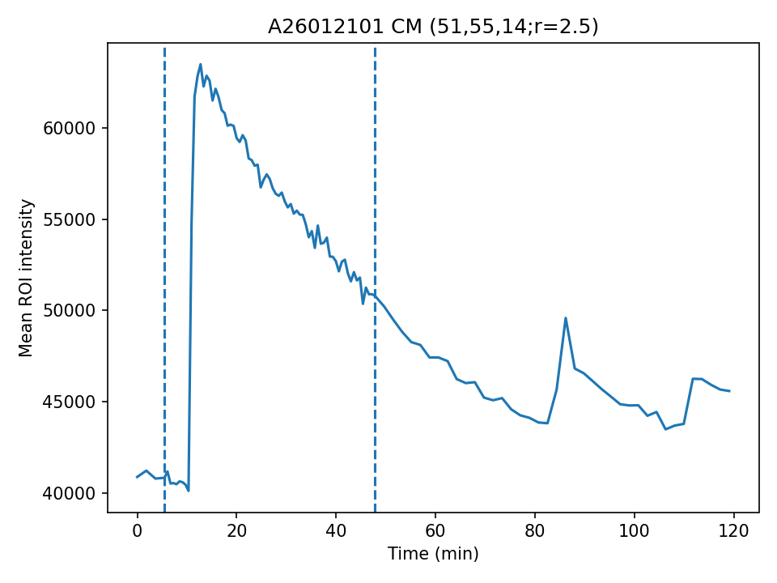
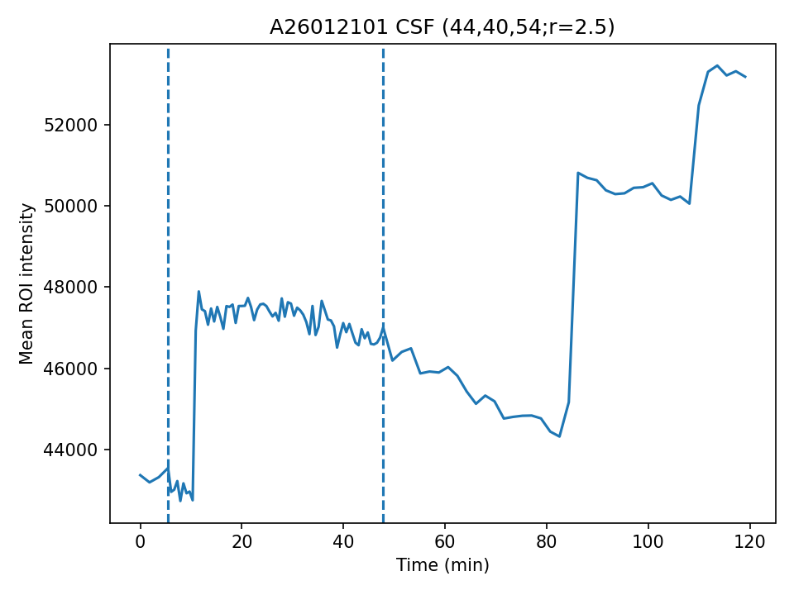
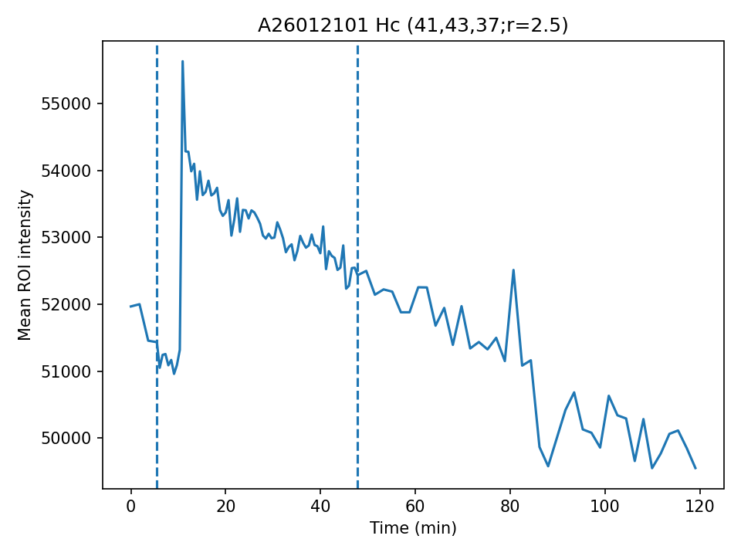
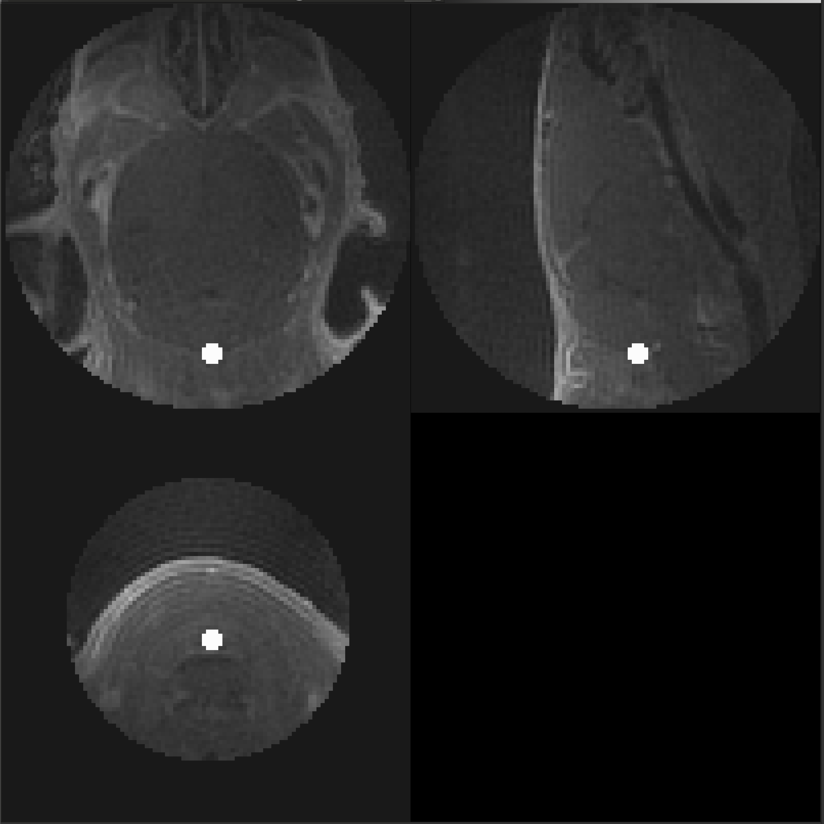
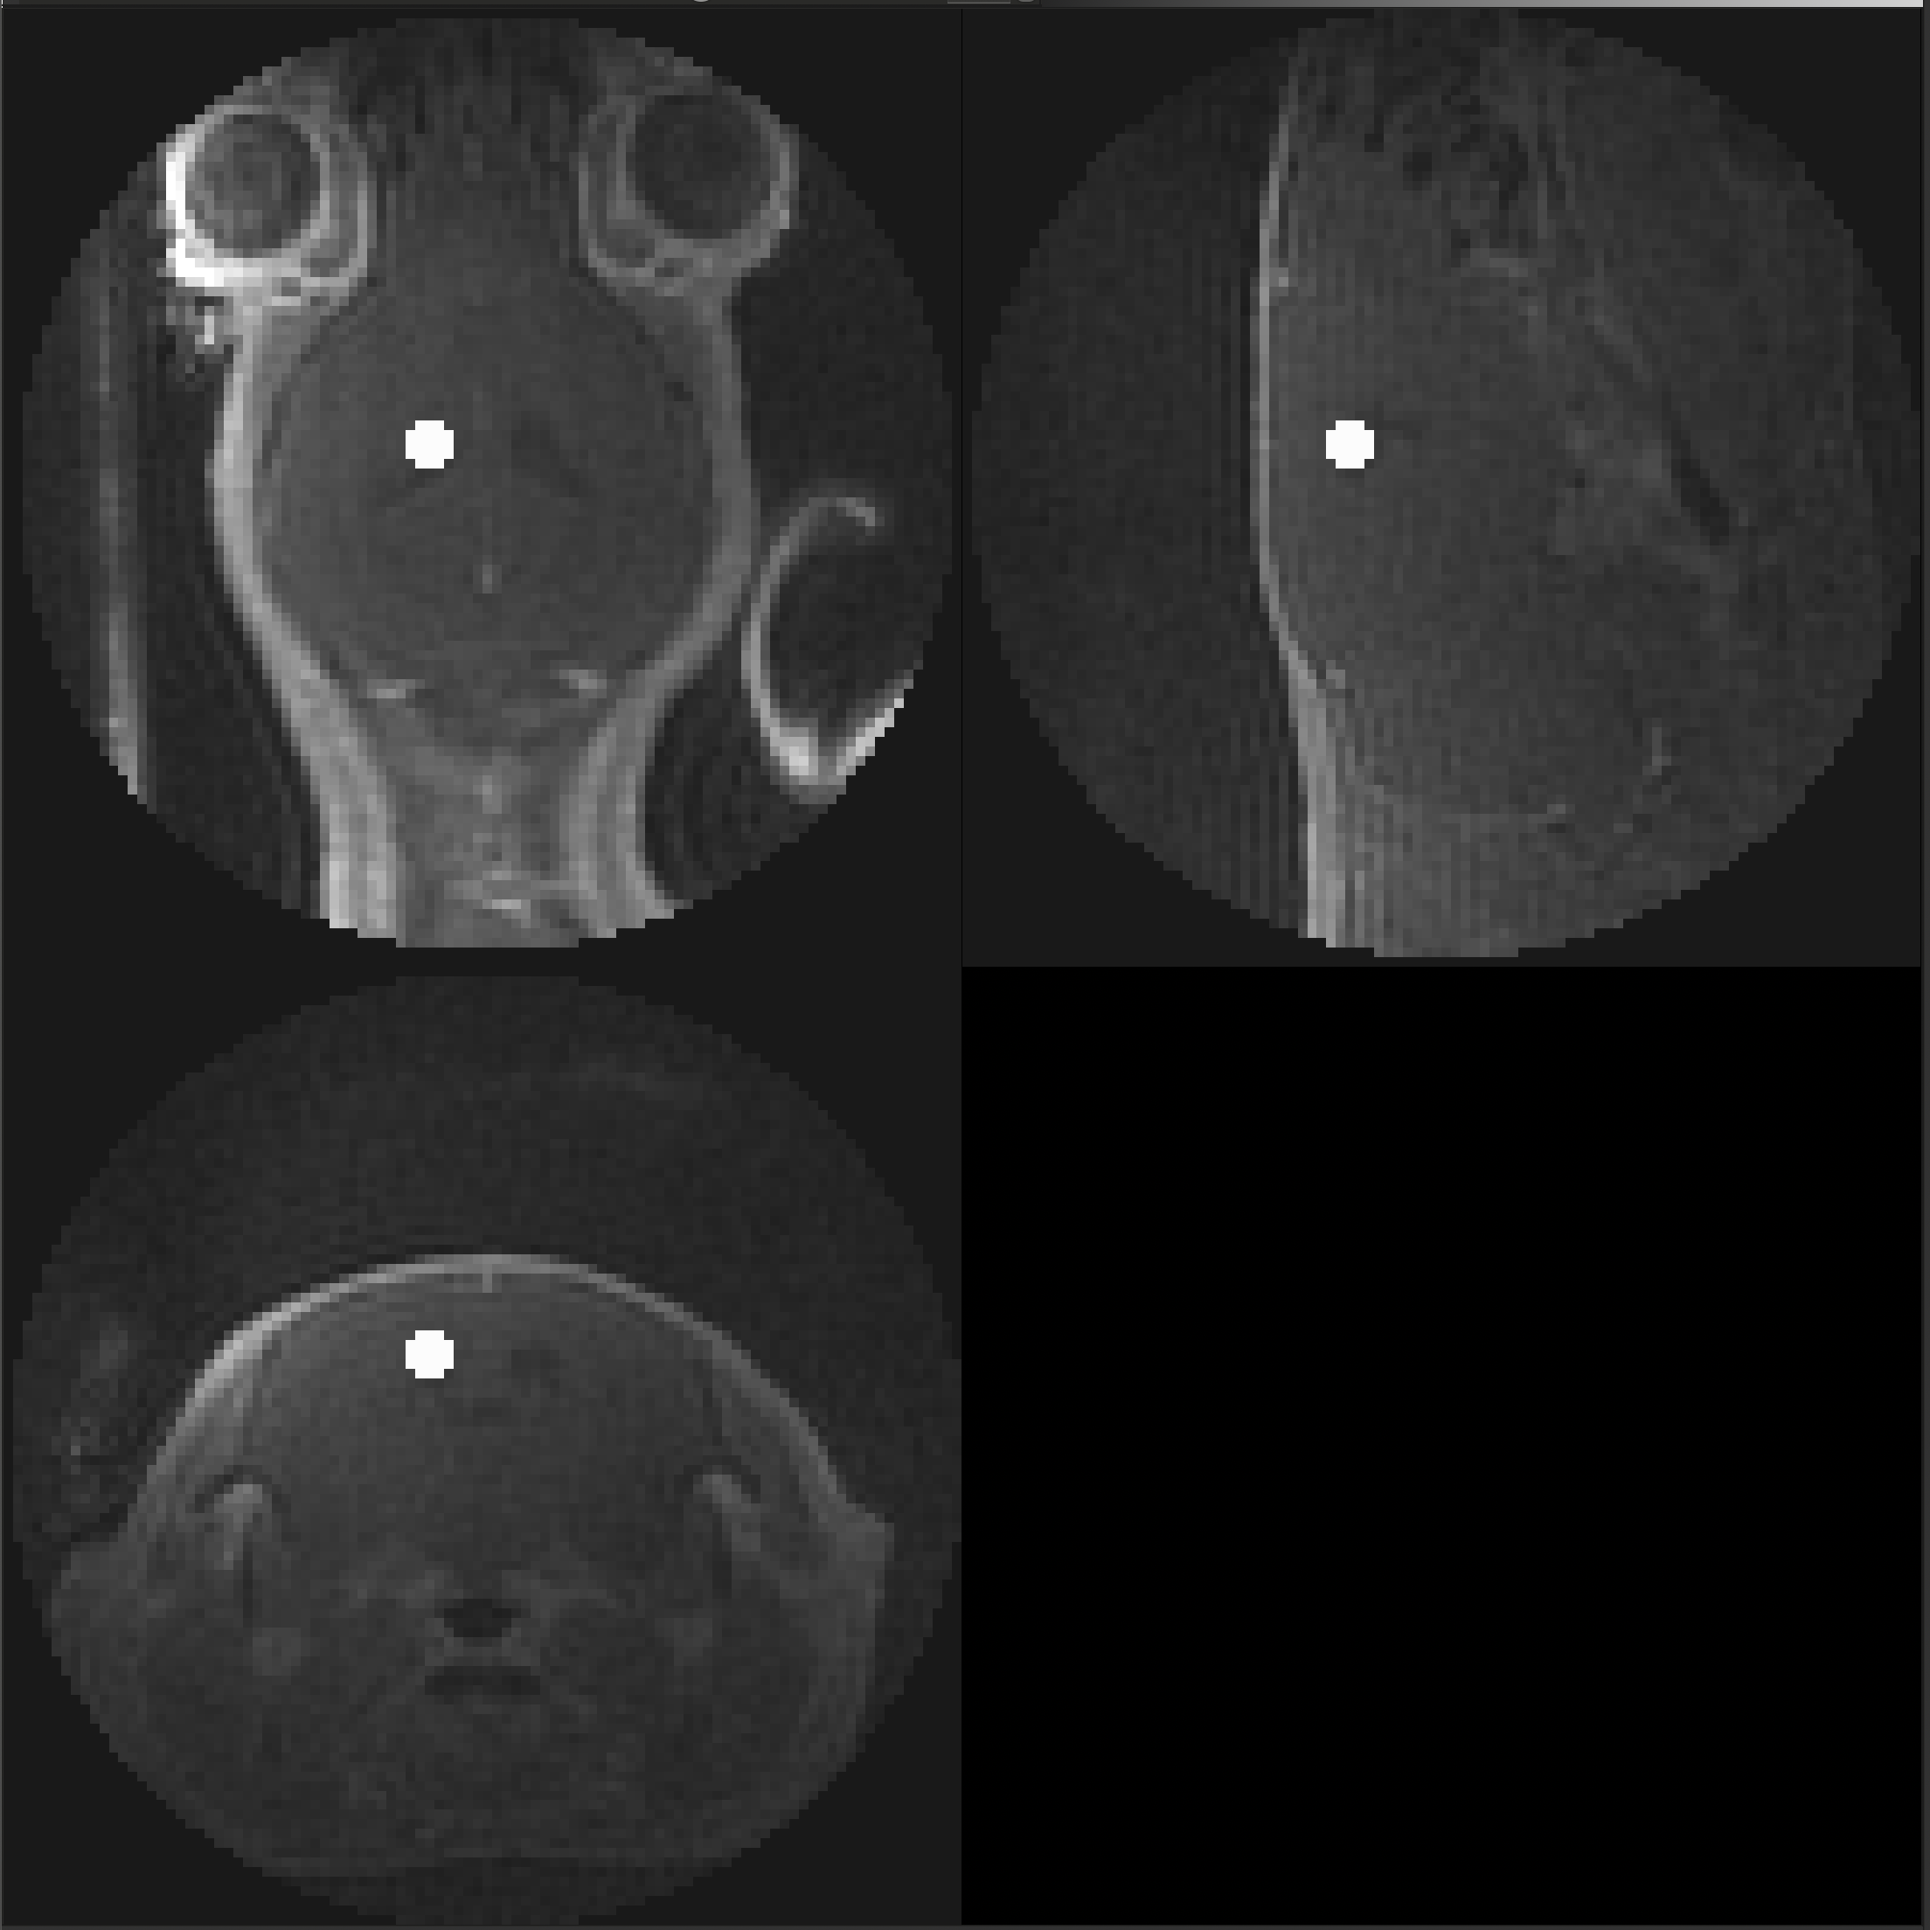
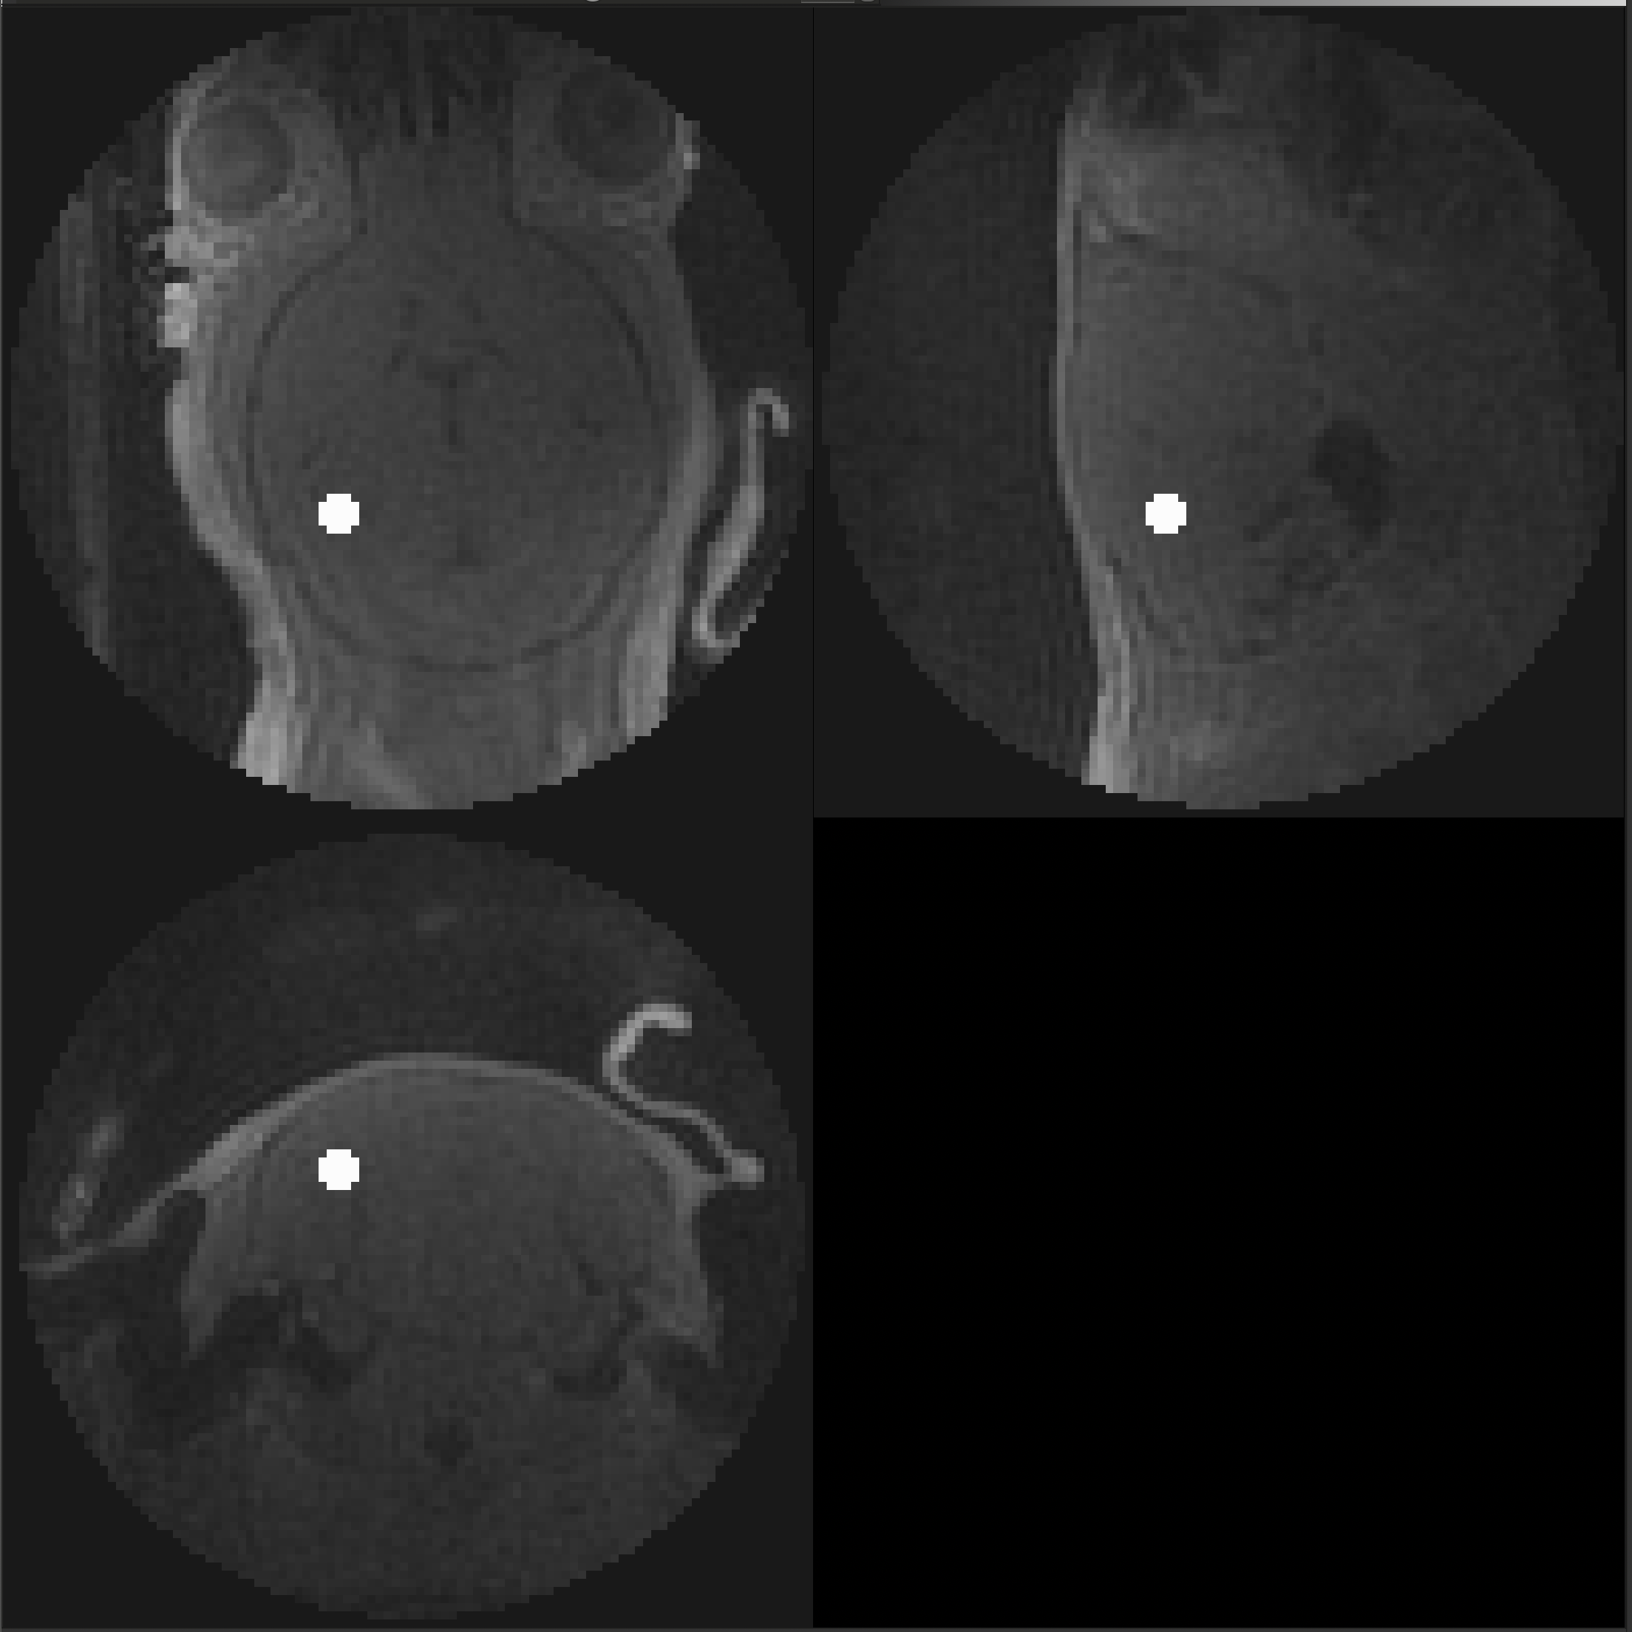
A26012101
Genotype: APOE
Method: IV
Usable: Yes
Cisterna Magna
Cerebral Spinal Fluid
Hippocampus

Slide 10
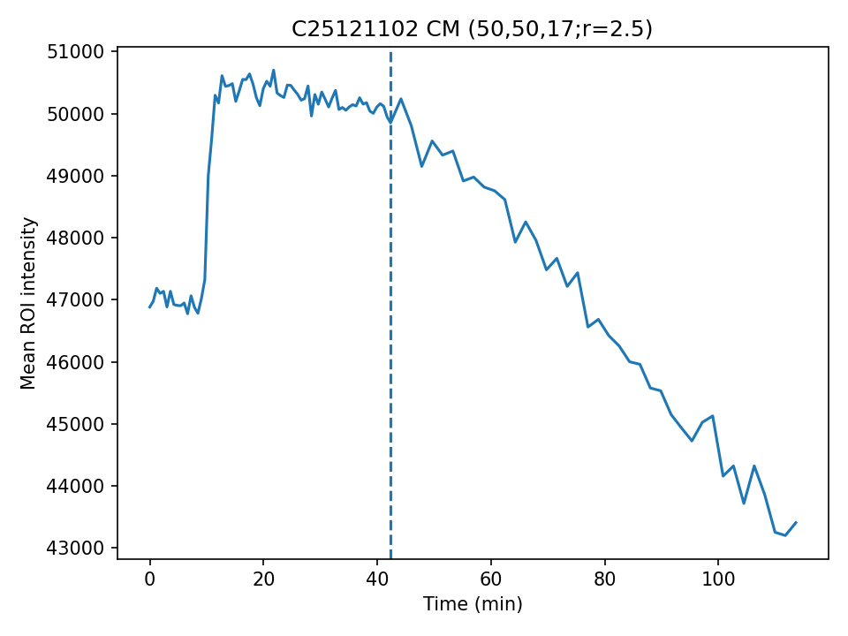
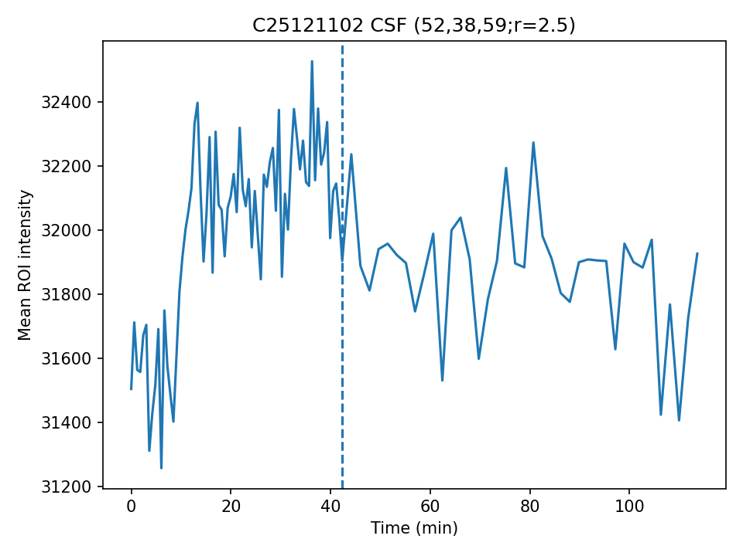
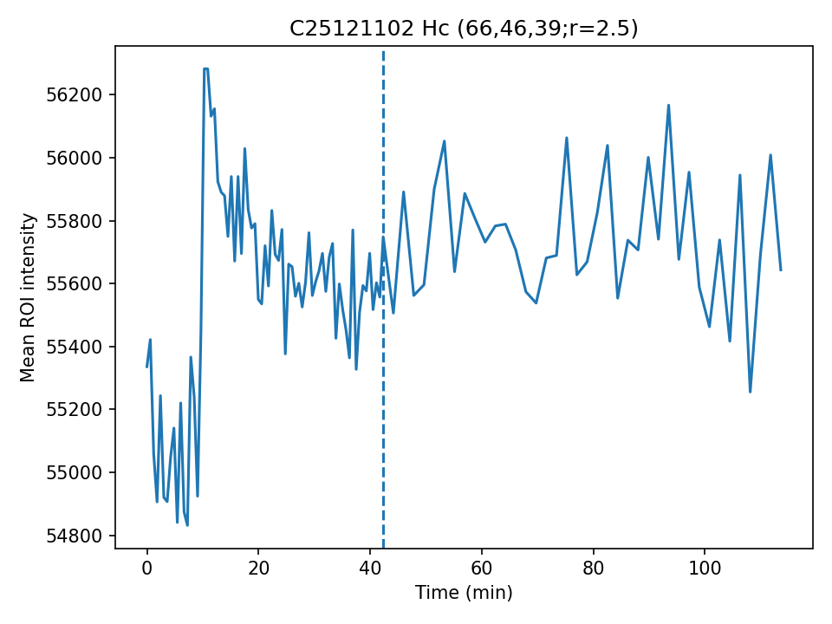
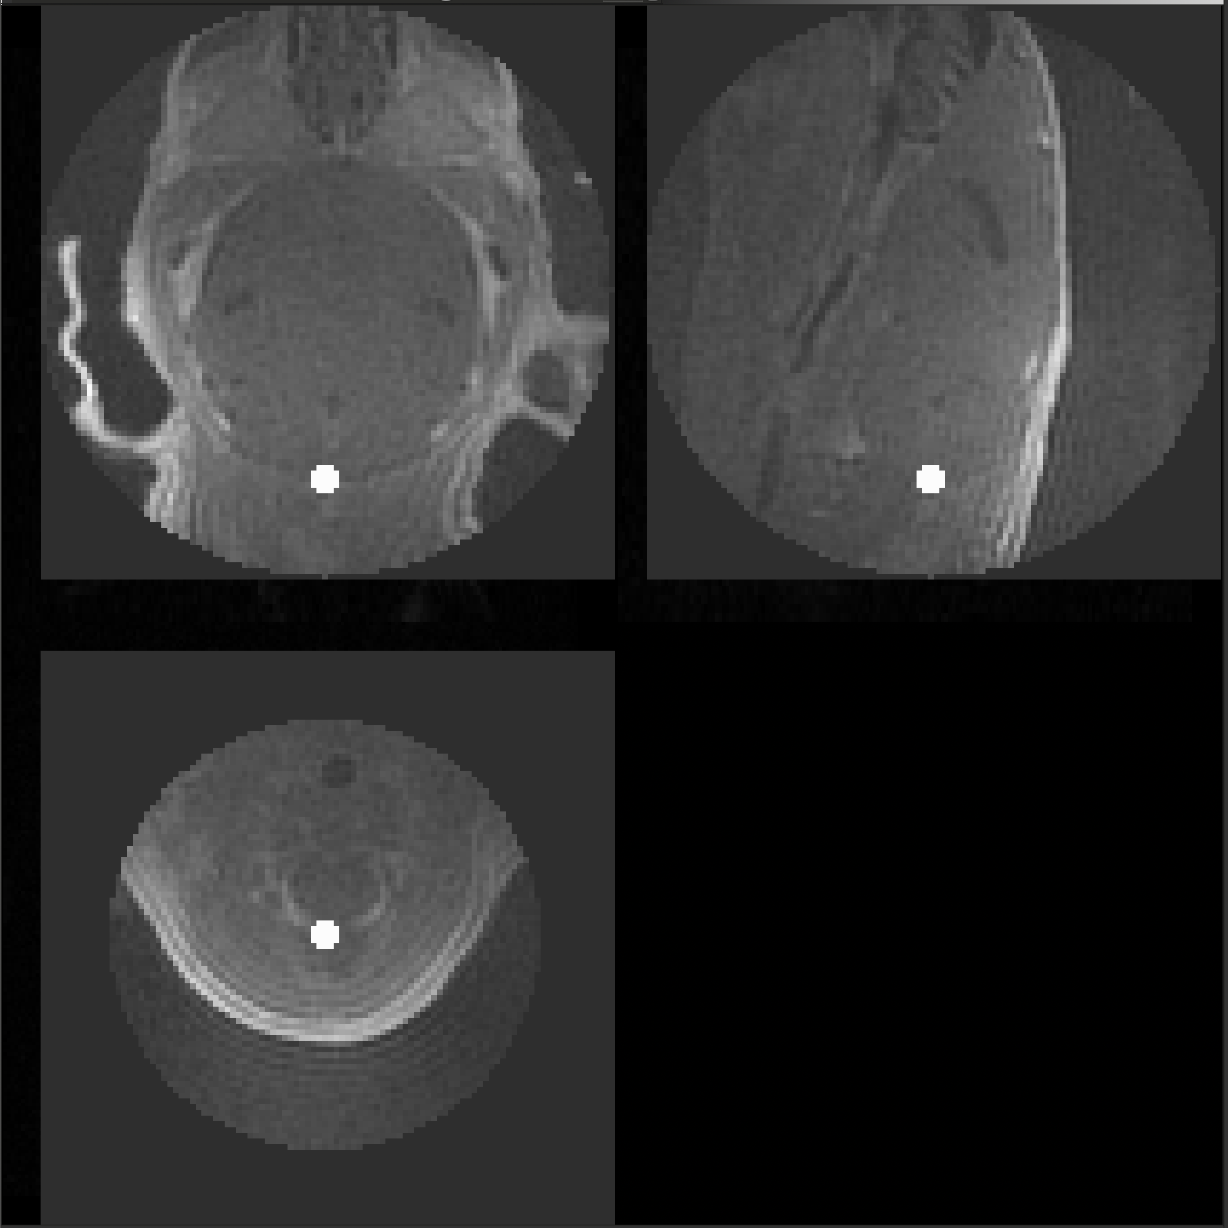
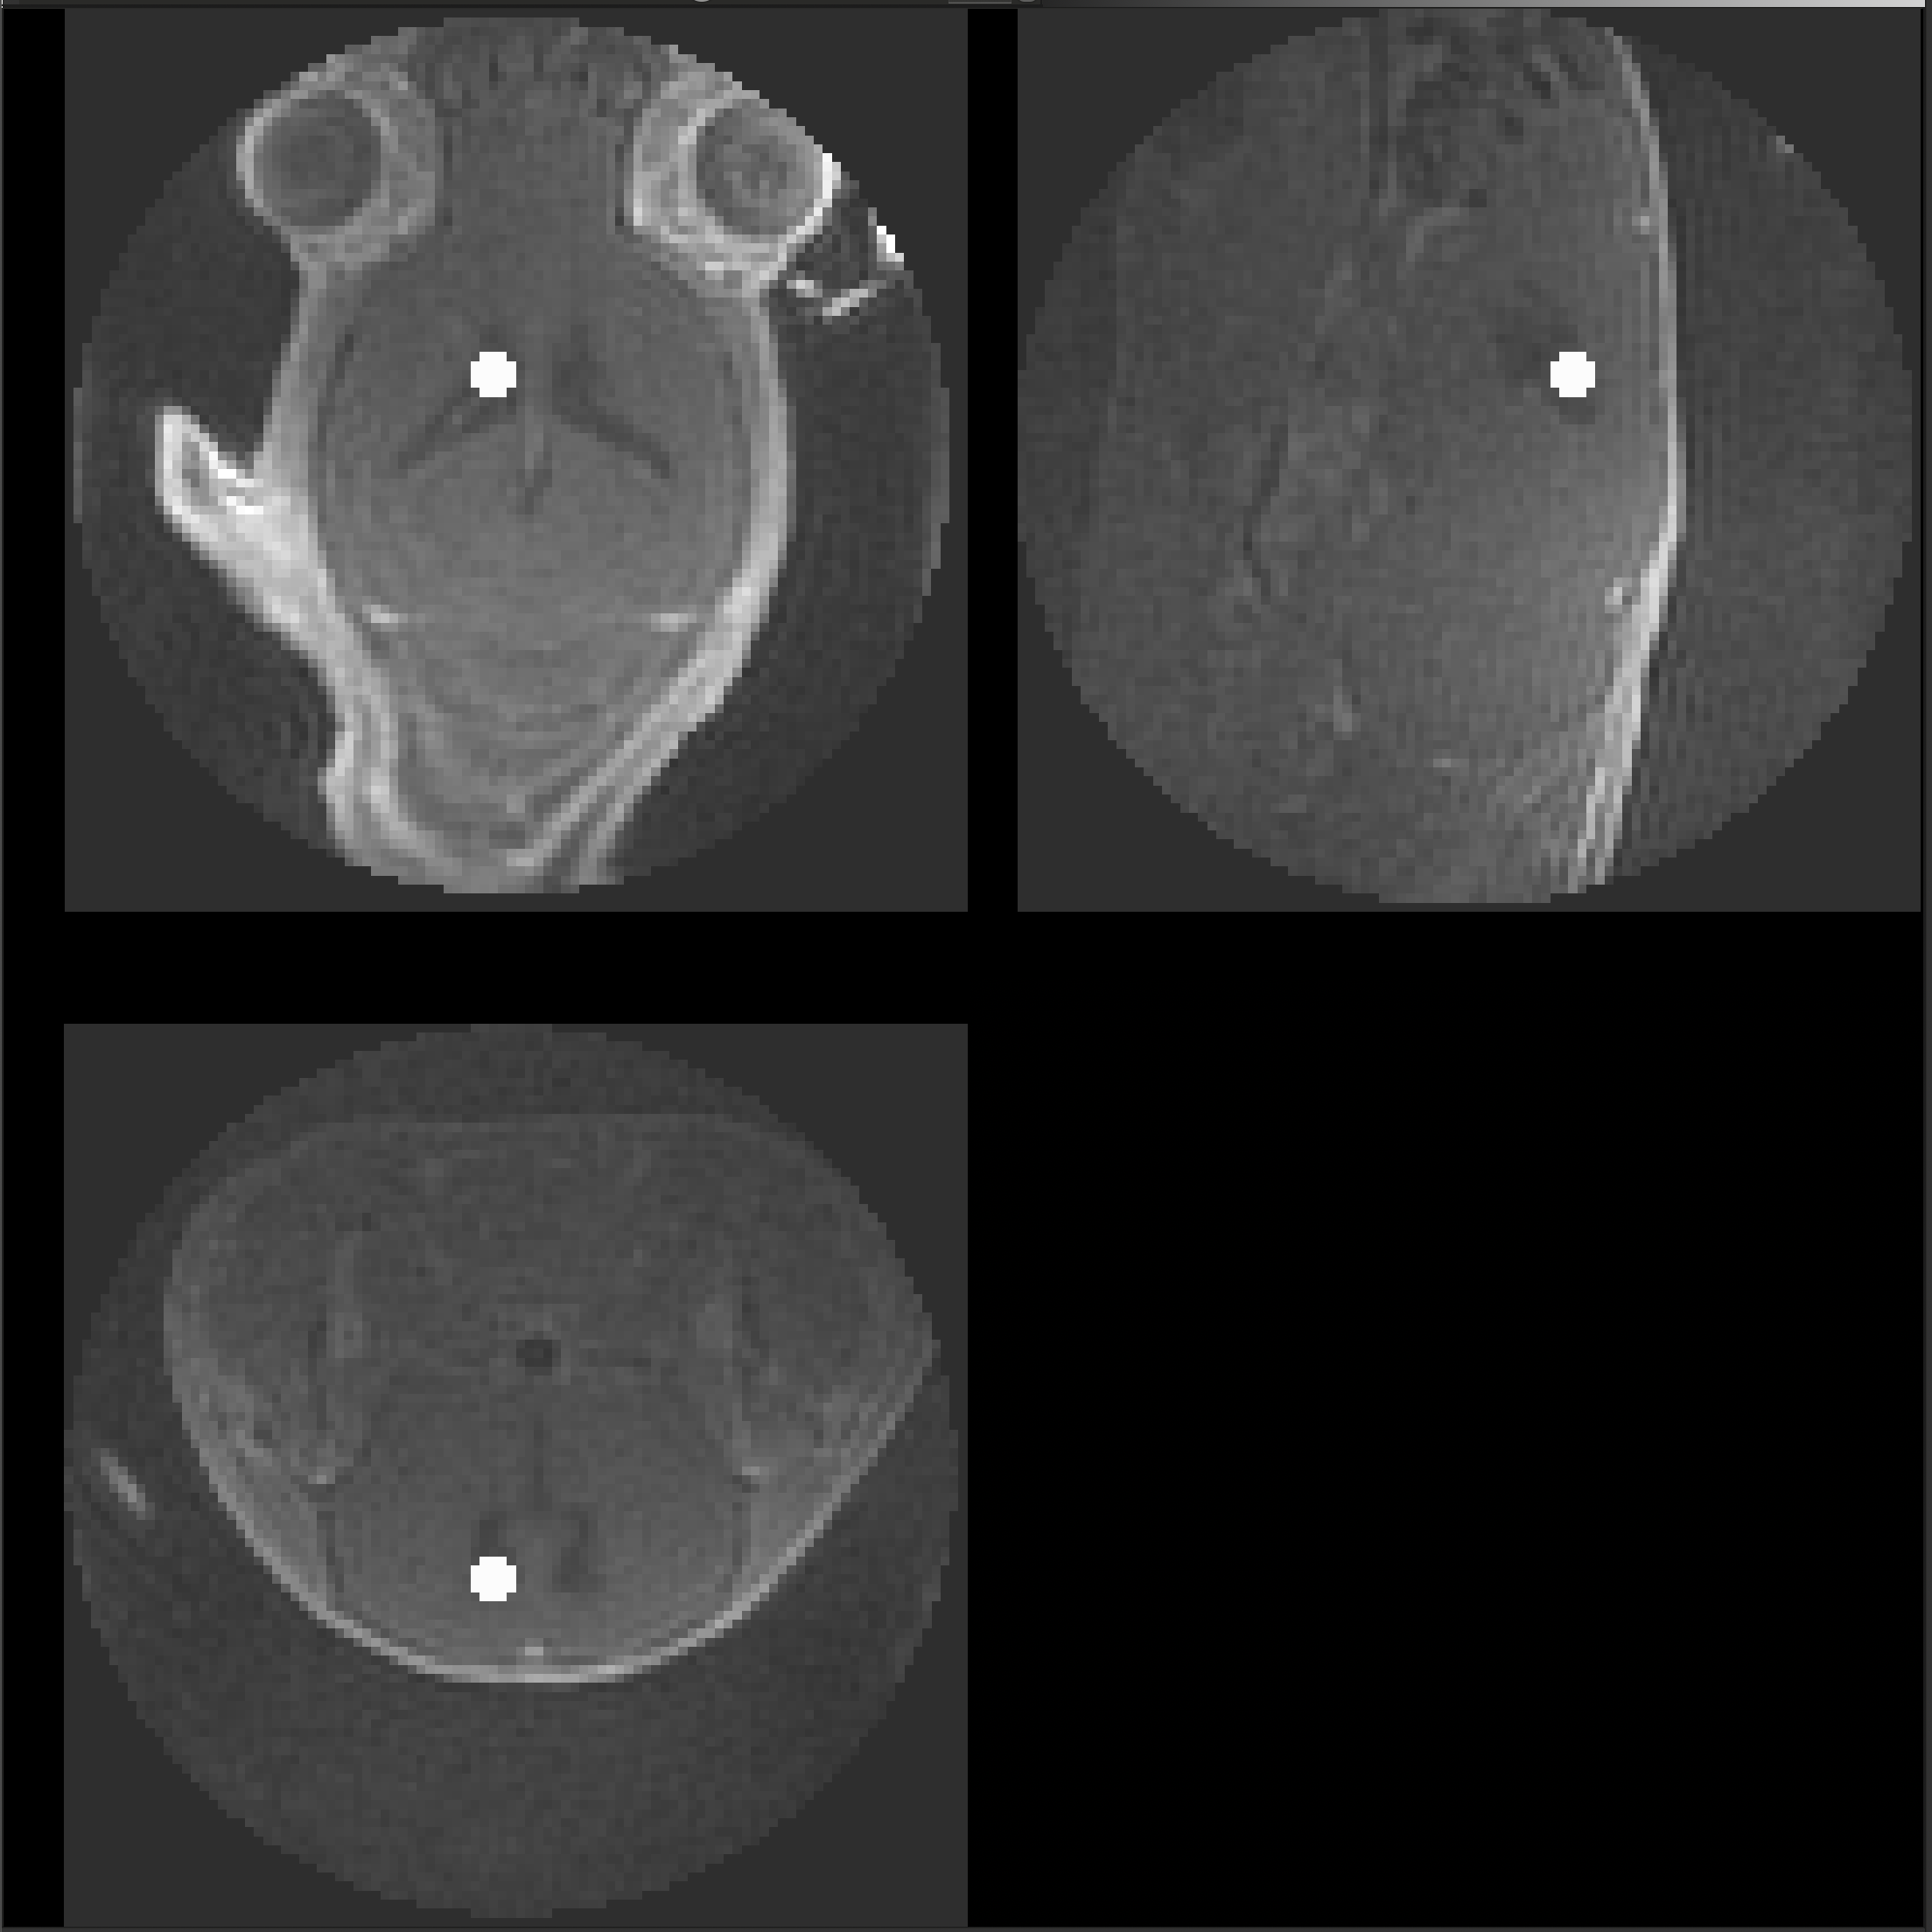
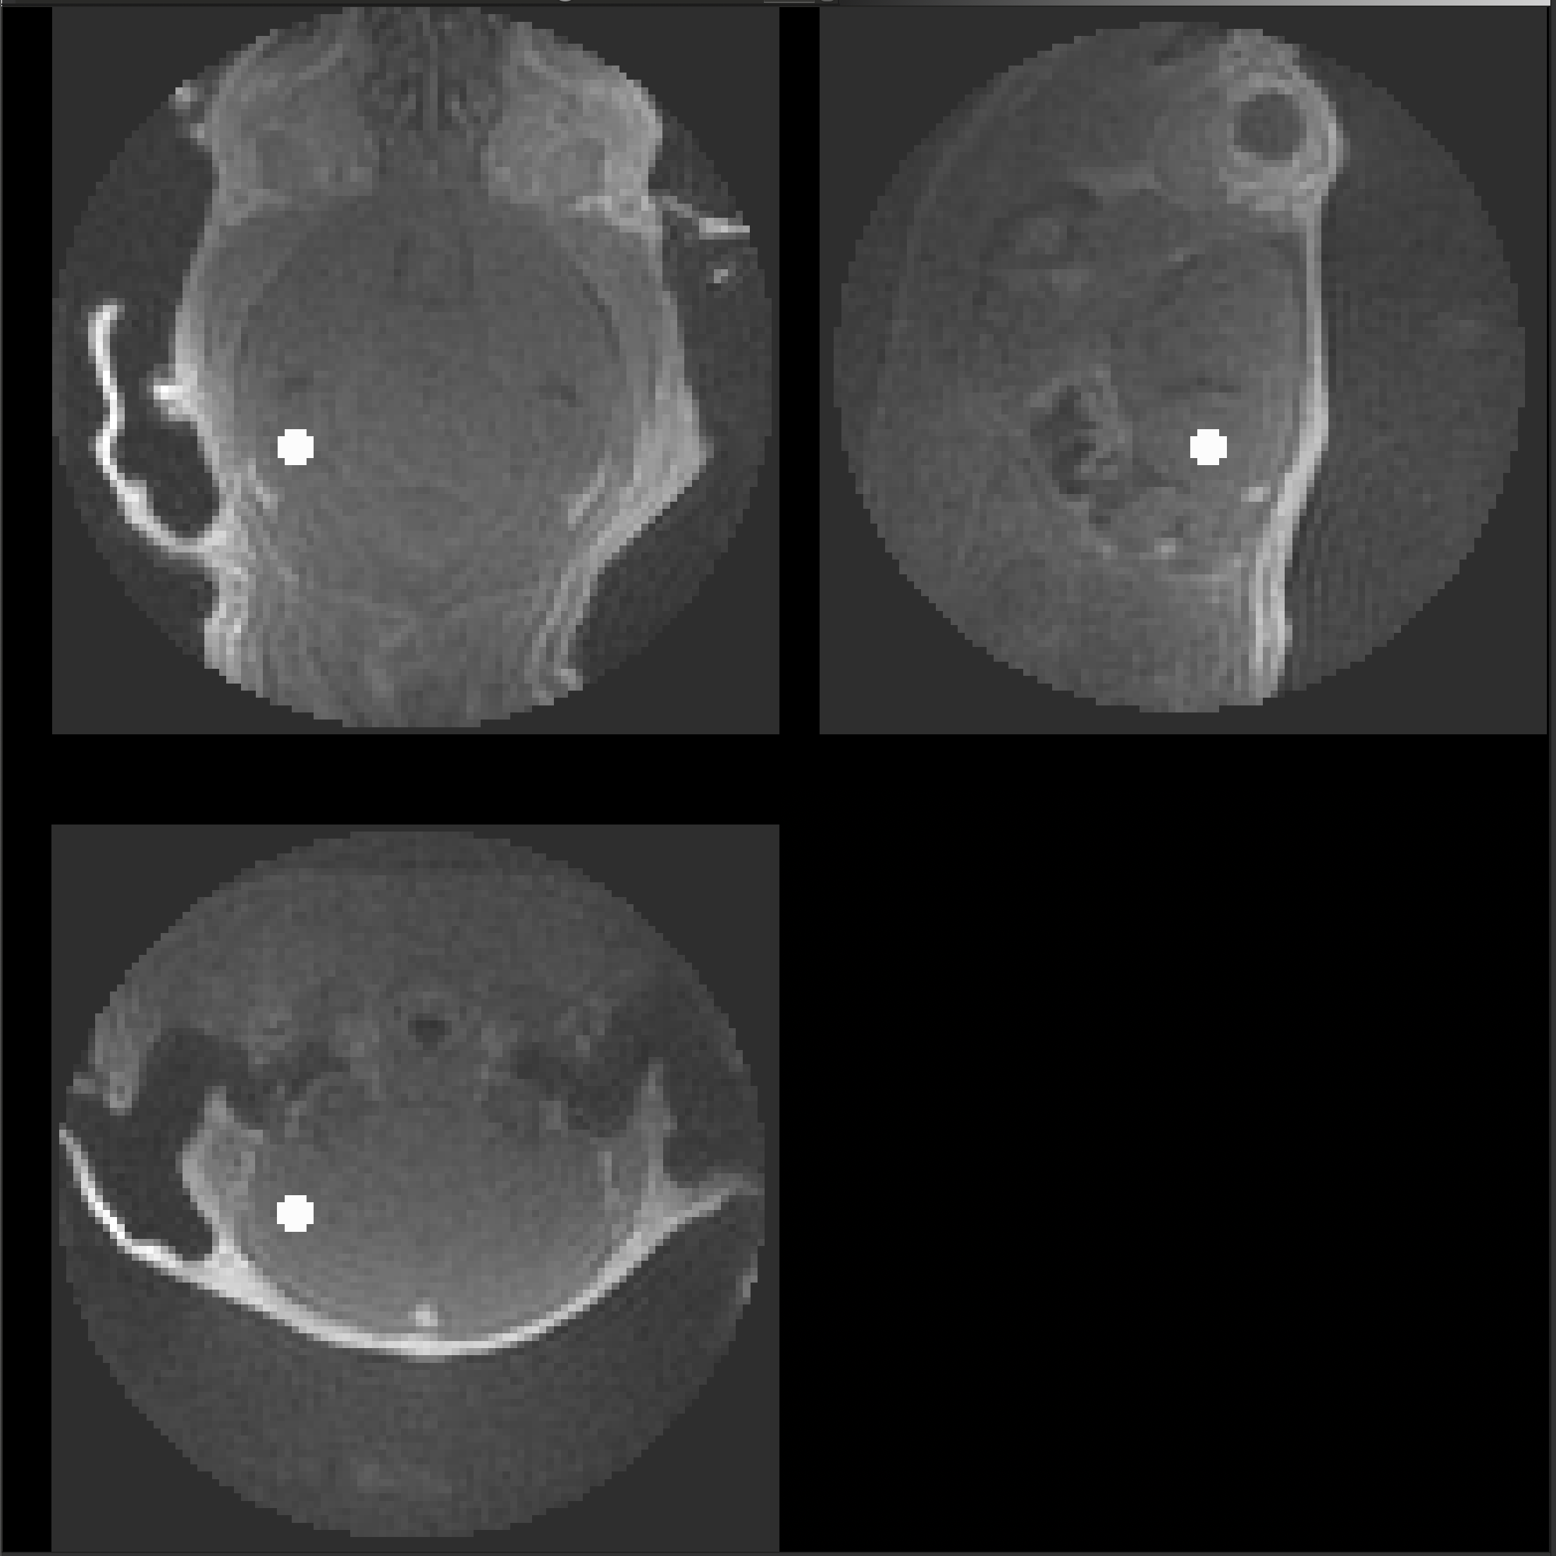
C25121102
Genotype: CVN
Method: IV
Usable: Yes
Cisterna Magna
Cerebral Spinal Fluid
Hippocampus

Slide 11
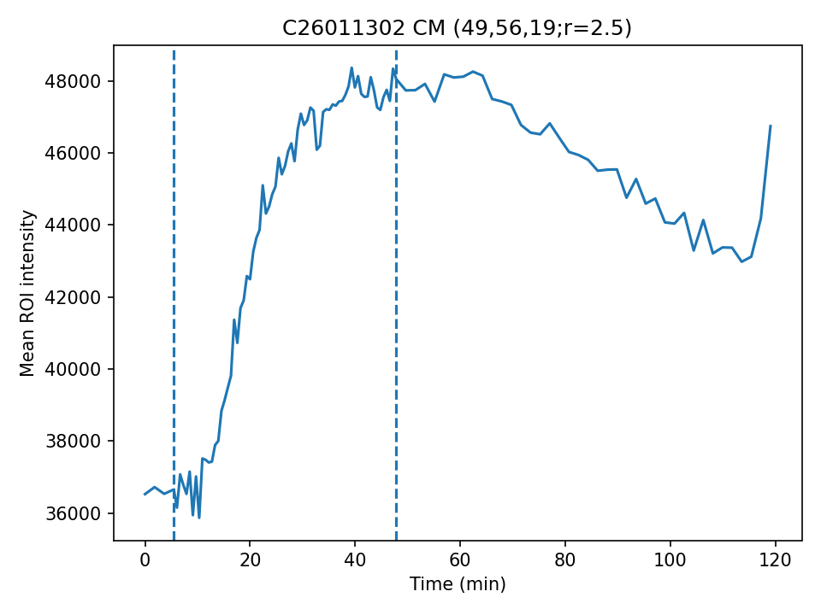
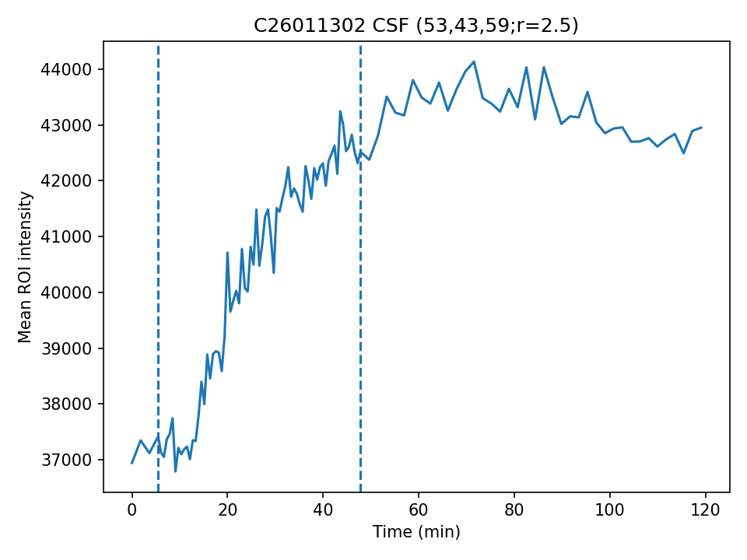




C26011302
Genotype: CVN
Method: IV
Usable: Yes
Cisterna Magna
Cerebral Spinal Fluid
Hippocampus

Slide 12






C26011303
Genotype: CVN
Method: IV
Usable: No
Cisterna Magna
Cerebral Spinal Fluid
Hippocampus

Slide 13






C26011401
Genotype: CVN
Method: IV
Usable: Yes
Cisterna Magna
Cerebral Spinal Fluid
Hippocampus

Slide 14






C26011402
Genotype: CVN
Method: IV
Usable: Yes
Cisterna Magna
Cerebral Spinal Fluid
Hippocampus

Slide 15






C26011403
Genotype: CVN
Method: IV
Usable: Yes
Cisterna Magna
Cerebral Spinal Fluid
Hippocampus

Slide 16






C26011501
Genotype: CVN
Method: IV
Usable: Yes
Cisterna Magna
Cerebral Spinal Fluid
Hippocampus

Slide 17






P26011505
Genotype: APOE
Method: CM
Usable: Maybe
Cisterna Magna
Cerebral Spinal Fluid
Hippocampus

Slide 18






P26011601
Genotype: APOE
Method: CM
Usable: Maybe
Cisterna Magna
Cerebral Spinal Fluid
Hippocampus

Slide 19






P26011604
Genotype: APOE
Method: CM
Usable: No
Cisterna Magna
Cerebral Spinal Fluid
Hippocampus

Slide 20






P26012002
Genotype: APOE
Method: CM
Usable: Yes
Cisterna Magna
Cerebral Spinal Fluid
Hippocampus

Slide 21






P26012003
Genotype: APOE
Method: CM
Usable: Yes
Cisterna Magna
Cerebral Spinal Fluid
Hippocampus

Slide 22






P26012005
Genotype: APOE
Method: CM
Usable: Yes
Cisterna Magna
Cerebral Spinal Fluid
Hippocampus

Slide 23






P26012101
Genotype: APOE
Method: CM
Usable: Yes
Cisterna Magna
Cerebral Spinal Fluid
Hippocampus

Slide 24






P26021101
Genotype: APOE
Method: CM
Usable: Maybe
Cisterna Magna
Cerebral Spinal Fluid
Hippocampus

Slide 25






V25121102
Genotype: CVN
Method: CM
Usable: Yes
Cisterna Magna
Cerebral Spinal Fluid
Hippocampus

Slide 26






V26011303
Genotype: CVN
Method: CM
Usable: No
Cisterna Magna
Cerebral Spinal Fluid
Hippocampus

Slide 27






V26011304
Genotype: CVN
Method: CM
Usable: Yes
Cisterna Magna
Cerebral Spinal Fluid
Hippocampus

Slide 28






V26011401
Genotype: CVN
Method: CM
Usable: Maybe
Cisterna Magna
Cerebral Spinal Fluid
Hippocampus

Slide 29






V26011402
Genotype: CVN
Method: CM
Usable: Yes
Cisterna Magna
Cerebral Spinal Fluid
Hippocampus

Slide 30






V26011403
Genotype: CVN
Method: CM
Usable: No
Cisterna Magna
Cerebral Spinal Fluid
Hippocampus

Slide 31






V26011501
Genotype: CVN
Method: CM
Usable: Yes
Cisterna Magna
Cerebral Spinal Fluid
Hippocampus

Slide 32






V26011502
Genotype: CVN
Method: CM
Usable: Yes
Cisterna Magna
Cerebral Spinal Fluid
Hippocampus

Slide 33






V26011504
Genotype: CVN
Method: CM
Usable: Maybe
Cisterna Magna
Cerebral Spinal Fluid
Hippocampus

